Slide 1
Preparing for Promotion to Full Professor
Deb Franko
Senior Vice Provost for Academic Affairs
October 11, 2023

Slide 2
But first, introductions
Name
Department and College
When did you join Northeastern?

Slide 3
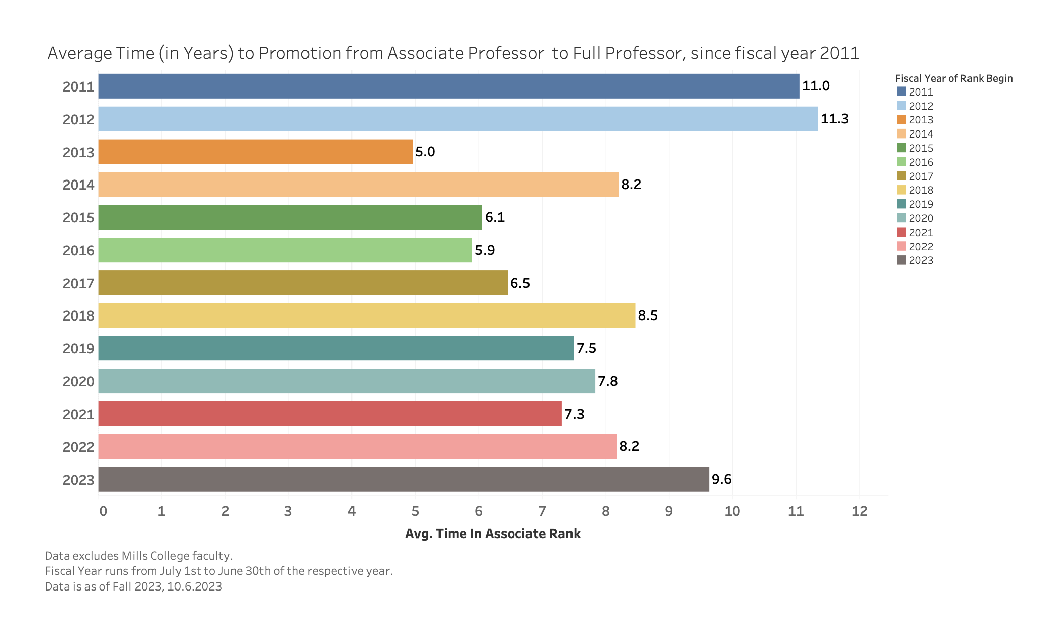

Slide 4
A few notes
Differences from tenure consideration:
No clock: You declare intention to be considered and have a conversation with your department chair and/or associate dean/dean
You are not “reminded” as in tenure
External Reviewers—all must be full professors or equivalent
Time span covered in dossier and supplemental materials
All research/scholarship/creative activity since tenure, and
All teaching and service since tenure, or
At least the seven most recent years of your teaching and service

Slide 5
What is expected?
Evidence of IMPACT
At a level distinct from and much higher than tenure consideration
Impact, not promise
With promise of your impact being sustained
Measured in a variety of ways (h-index, leadership, innovation, external letters)

Slide 6
Evidence of Impact in Teaching
might include, in addition to continuing excellent classroom performance:
Wider range of curricular contributions than at tenure
Innovative pedagogy beyond what you did for tenure
Program development beyond the course level
Mentoring of junior teachers
Lengthening record of students placed, publications with students; your students’ success is yours
Contributions to your field’s pedagogical debates
Leadership in the curricular and pedagogical space

Slide 7
Evidence of Impact in Research/ Scholarship/Creative Practice
might include, in addition to continuing to publish and present your work, obtain grants, present creative works . . .
Citations and reviews of published work
Increasing stature of publication venues
Prestigious invitations; prestigious gallery showings or juried exhibitions
High-profile professional service dependent on scholarly reputation
Leadership in your field of study
Engagement in larger-scale research collaborations; large grants
International as well as national reputation

Slide 8
Evidence of Impact in Research/ Scholarship/Creative Practice
As noted by your external reviewers
Who come from high ranking institutions and are leaders in the field
Who speak clearly to the impact of your research/scholarship/creative practice in the field
They know your work and discuss its value
They comment on the impact you have made in the field
They likely know about your leadership in your profession
They affirm, strongly, that you should be promoted to Professor and would be promoted at their university

Slide 9
Evidence of Impact in Service-Leadership
might include, in addition to robust departmental citizenship. . .
Leadership at and beyond the university
Shift from “service” towards academic leadership—at all levels of contribution
Contribution to the success of others
Wider college and university roles with demonstrable outcomes (e.g., Committee Chair, not Committee Member)
Visible professional service premised on scholarly reputation; Leadership in professional organizations
Editor of journal – not just on editorial board or ad hoc reviewer
Responsibility for improvement as well as continuity

Slide 10
What will my promotion dossier contain?
Dossier proper distills your accomplishments
Curriculum Vitae
Statements reflecting on your trajectory in research, teaching, service
Summary of teaching evaluations
Previous performance evaluations
Your unit’s promotion committee then adds…

Slide 11
Included in Dossier by Committee
Confidential letters from external experts in the field evaluating your research/scholarship/creative work
6-8 “arm’s-length” letters
Candidate may suggest referees and may request that some scholars not be considered as referees; final list by unit committee with dean’s review
Chair’s report, presented to unit promotion committee
Unit report, including vote
College advisory committee report (where applicable)
Dean’s recommendation
Candidate’s responses, if any, to unit/college/dean

Slide 12
What will my appendices contain?
Appendices document your accomplishments in teaching, research, and leadership
All copies of publications, artistic programs, etc.
Record of external funding
Evidence of impact, if available—book or performance reviews, citations
Teaching evaluations
Sample syllabus and course materials
Evidence of leadership in discipline and university

Slide 13
Promotion review for joint appointments
Faculty Handbook module on tenure and promotion of jointly appointed faculty
Representative of secondary unit(s) of appointment serves on promotion committee with full rights and responsibilities
Both primary and secondary unit deans contribute independent evaluations of the candidate (for cross-college joint appointments)
If faculty member serves in units with chairs or equivalent unit heads, secondary unit head contributes to the primary unit chair’s evaluation letter
See https://faculty.northeastern.edu/handbook/

Slide 14
Model Tenure and Promotion Dossier
Reflects Full Professor process
https://provost.northeastern.edu/app/uploads/Updated-Model-Tenure-Dossier_July-1-2021.pdf
Follow all guidelines in this document
100 page total = ~ 60 pages of material you supply
+
~40 pages of materials from your committee

Slide 15
Interfolio
Dossiers must be submitted electronically through Interfolio
Access Interfolio via the MyNortheastern portal using your Northeastern credentials Interfolio facilitates the online submission and review of materials
Candidate submits dossier materials and appendices
Department or College collects and submits Faculty Summary Sheet, recommendations, and external letters
Software is intuitive, any specific questions can be directed to your Associate Dean for Faculty Affairs or Jackie Isaacs, Vice Provost for Faculty Affairs

Slide 16
Questions?
THANK YOU!

Slide 17
Please fill out the evaluation survey left on your seat.
THANK YOU!

