Slide 1
Professional Development Opportunities for Faculty and Cross-College Collaborations
Deb Franko
Senior Vice Provost for Academic Affairs
October 19, 2023

Slide 2
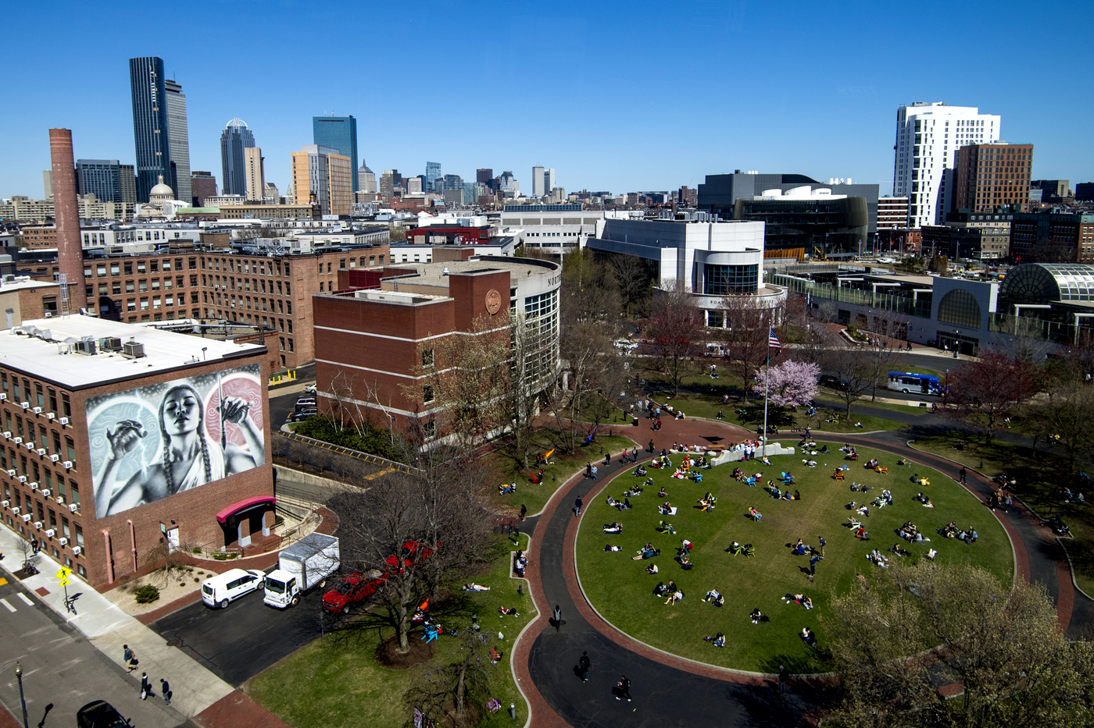
Northeastern University: The past

Slide 3

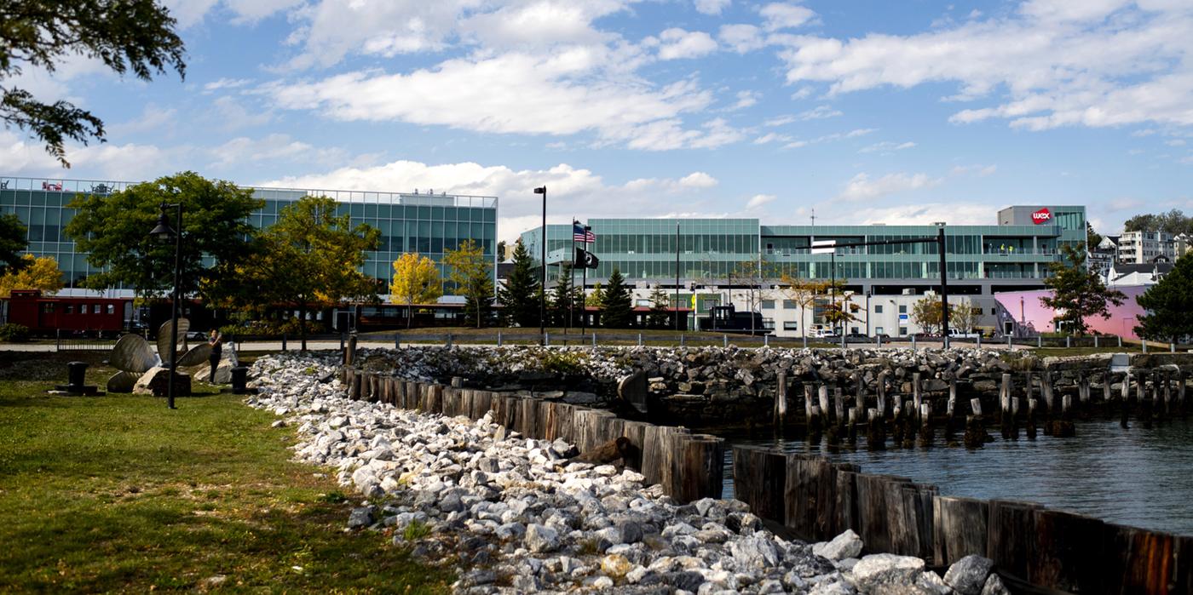
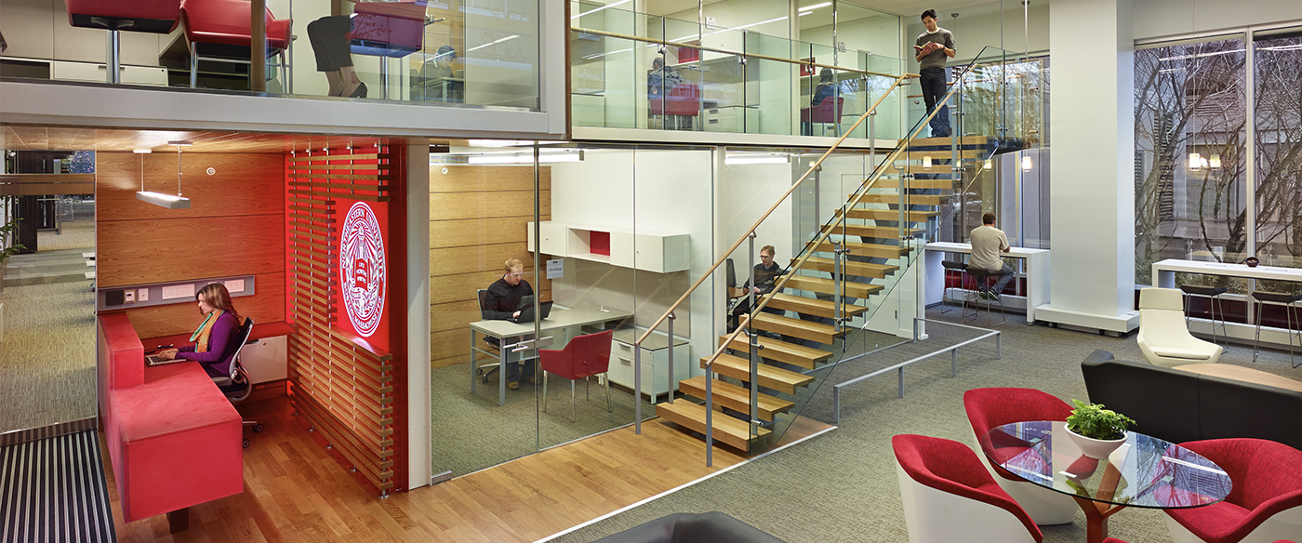
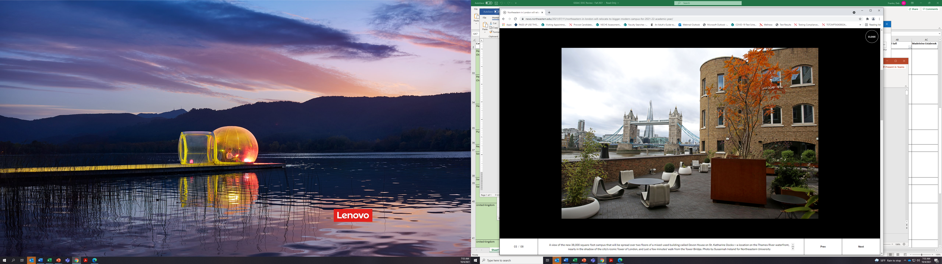
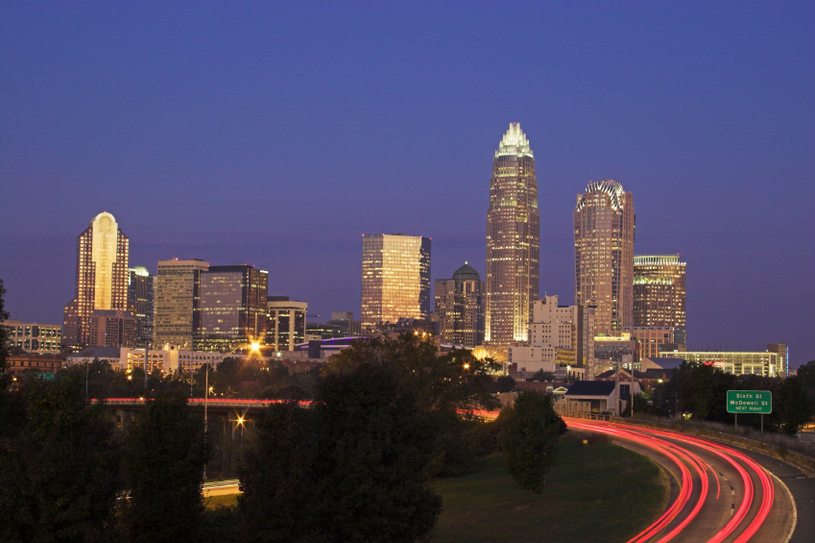
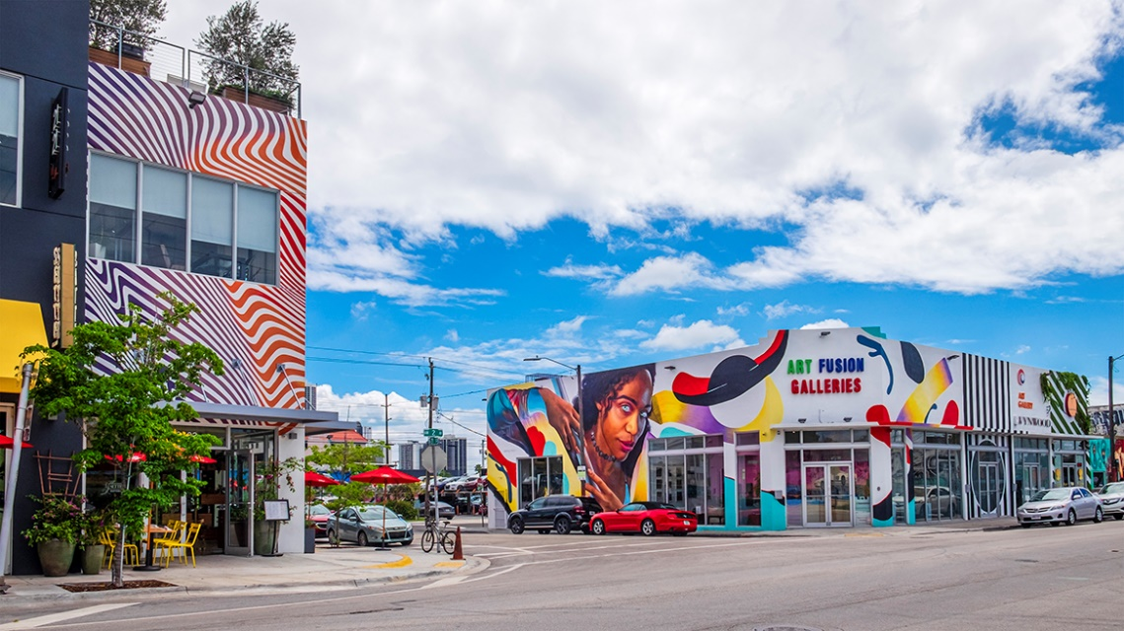
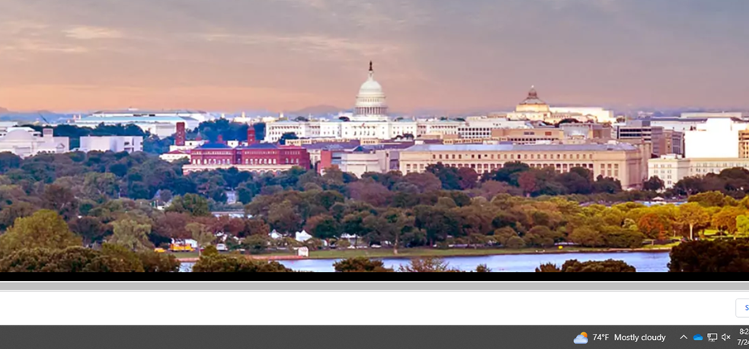
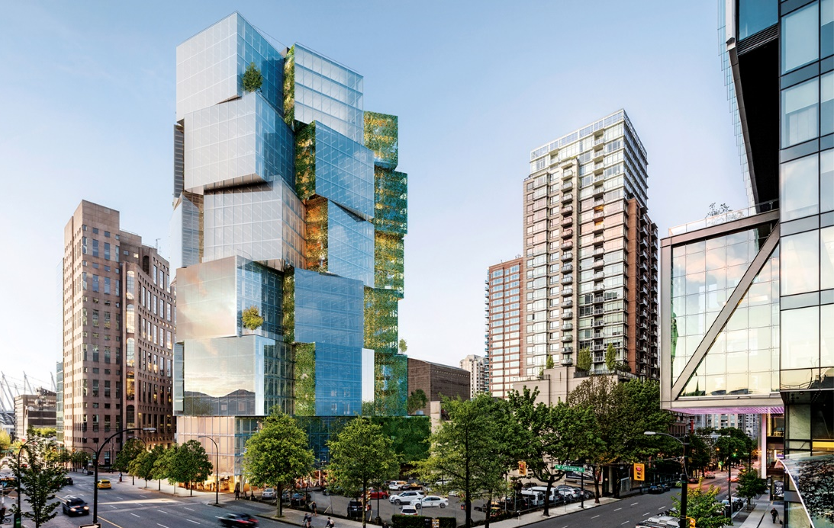
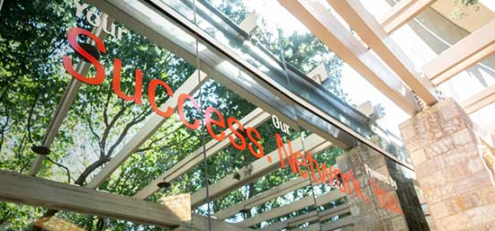
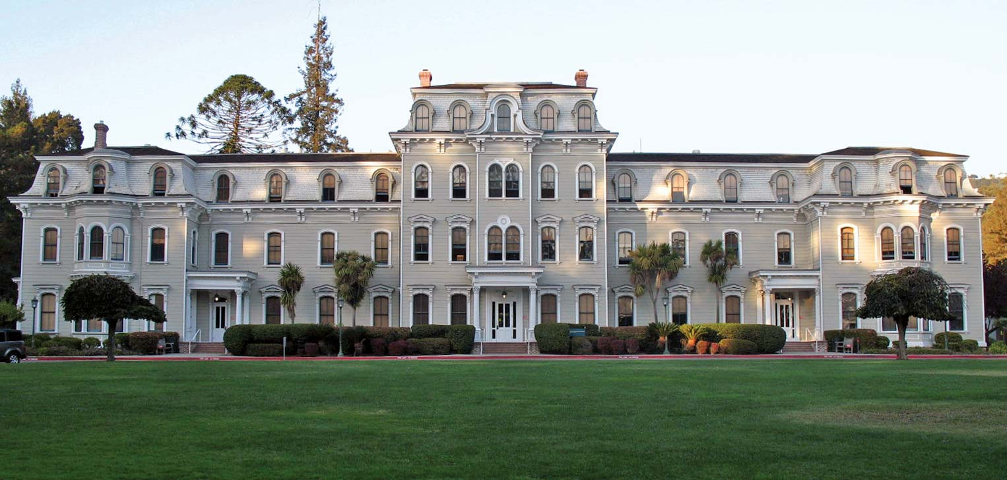
Seattle
Portland,
Roux Institute
Toronto
Northeastern University NOW!
Arlington
Northeastern
London
Miami
Charlotte
Mills College at Northeastern University
Vancouver
Silicon Valley

Slide 4


“How do I navigate this big Global University System?”
Boston
London
Oakland
Arlington
Burlington
Nahant
Charlotte
Miami
Portland
San Francisco
San Jose
Seattle
Toronto
Vancouver
Undergraduate | Lifelong Learning | Research | Entrepreneurship
Notes:
Mary Ludden:
Residential: Boston, London, Oakland
Research-first: Arlington, Burlington, Nahant
Lifelong Learning-first: Charlotte, Miami, Portland, San Francisco, San Jose, Seattle, Toronto, Vancouver
All Campuses: Undergraduate, Lifelong Learning, Research, Entrepreneurship
Overview
From FY15 to the present, the global network has served more than 6,700 learners and generated more than $160M In total revenue to the institution.
Current revenue projections for FY23 are $150.1M this academic year.
Looking across the university, global network enrollments account for nearly 60% of the overall growth in graduate program enrollment at the university with more than 25 graduate programs currently offered across the network.
We continue to launch additional programs on our existing campuses and expand to new locations. Grad programs are set to launch on the Arlington campus in spring 23 and in Miami fall 23. We expect continued growth across the network over the next three years.​
Roux Institute:
More than 300 graduate learners are enrolled, and the Institute is working with more than 65 industry, academic, and community partners.
15 startups are working in residence at the Roux, including 10 participating in the Institute’s inaugural accelerator, operated in partnership with Techstars.
Toronto:
1,268 enrolled student this fall.
New programs launching in January 2022 (MS Information Systems) and September 2023 (MS Biotechnology) 2 additional programs have been submitted to the Ministry for review to Launch in fall 23
Relocating to Queen St location in fall 24
Seattle:
Expanded global mobility and undergraduate offerings by launching Global ConnEXions, SemesterIn, Aerospace and summer residency programs.
Broadened support to students across the network by expanding Global Learner Support program from Seattle to SFBA, Vancouver, and Toronto campuses.
London:
This Academic year London welcomes NU Bound, Global Quest, Semester In, and NUin programs. ​
Brokered strategic UK funding partnerships—for example, with UKGov, NHS, Department for Education, Greater London Authority, Apprenticeships Levy, etc– and will be adding business and tech content to NCH programmatic offerings.
Vancouver:
Initial focus on Khoury has supported rapid growth, with +300 students expected in the program by January 2022
Launching three new programs in September 2022 (CAMD, CoE, CPS)
Developing strategy to support indigenous learners and pathways to tech careers
Charlotte:
Refocusing on Health Sciences.
Scheduled to occupy 50k sf building “The Line” in January 2023.
San Francisco and Silicon Valley:
Both campuses had significant construction and design work completed this past year, which enhance the overall student experience, increase collaboration and study space, and expand new and improved classrooms to meet capacity demands.
The campuses have moved forward in implementing a shared services model with Khoury and CPS across career services and experiential education. This creates a highly leveraged resourcing model to better support our learners and decrease scaling costs on individual colleges.
Arlington: Launching in spring 23: Programs in project management, analytics, computer science, Align, Urban informatics, applied quantitative methods, and security and resilience studies
Miami: Launching 7 programs fall 23. (MS Project Management, BS Analytics, BS Biotechnology, BS Finance & Accounting, BS Management, BS Project Management, MS Computer Science + Align)
Objectives:
Sustainable and Secure Technology - Prepare learners to take part in the emerging tech ecosystem with particular emphasis on the fields of finance and health.
Workforce Upskilling and Reskilling - Deploy top performing degree and certificate programs that allow learners to upskill and reskill with new professional tools and competencies that are relevant and in demand.
Inclusive Talent Pathways - Offer a range of opportunities that allow learners to personalize their educational journey recognizing unique and diverse demographics of the region.
Mills College: Formed integration workstreams with Northeastern and Mills co-leads, and are beginning the accreditation process. A Semester In program is planned on the Mills campus for spring 2022, and we are taking applications for Northeastern student leaders to participate in Leading Social Change– a spring 2022 semester-long social justice leadership opportunity at Mills College. Launching first cohort in fall22. NUIn & NU Inbound

Slide 5

Experience Unleashed: Our Academic Plan (and north star)
Activate the Global
University
System
Personalized, experiential
learning
High Impact
Research
Diversity, Equity
and Inclusion
Technology and
Service Excellence
Notes:
David Madigan
We will:
Focus on diversity and inclusion in every context
Wholly immerse learning and discovery in experience, untethered from the disciplinary boundaries
Build interdisciplinary clusters of partners, faculty, staff and students around specific real-world challenges. We call these impact engines
Go to world. We will build out a truly global university and aspire to total mobility
Empower this vision and scale and service excellence through technology
Commitment to sustainability throughout the curriculum…

Slide 6
Today’s Topics
  Opportunities and tips for creating cross-college collaborations
  Professional Development resources
  Specifically:
    ADVANCE Office of Faculty Development
    Professional development opportunities around the university
    Professional development funding opportunities
  Your thoughts, ideas, and questions

Slide 7
Northeastern (Boston and beyond) is a big place. It takes time to get to know it and all the people there.

Slide 8
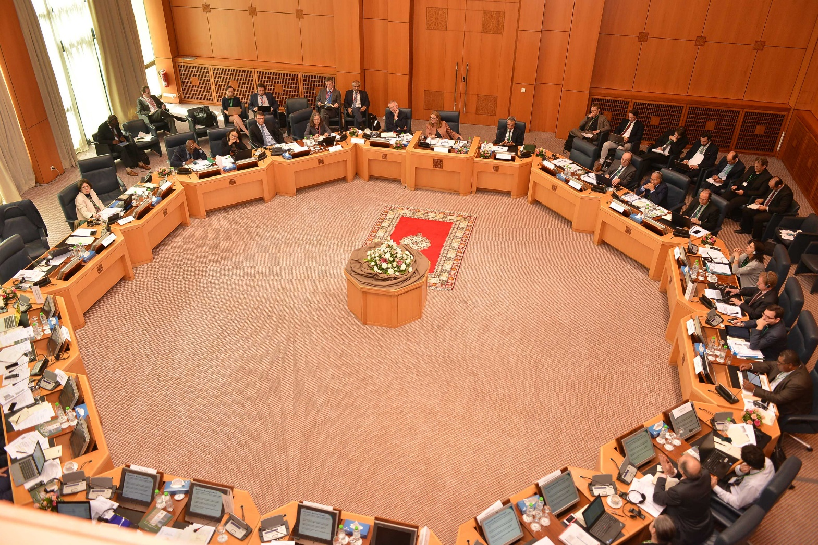
Finding collaborators and working together also takes time, and effort.

Slide 9

What do you need to be successful in cross-college collaborations?
Getting to know people?
Funding?
More time?
Better ideas?
Goals and a plan?
Mentor?
All of the above?

Slide 10
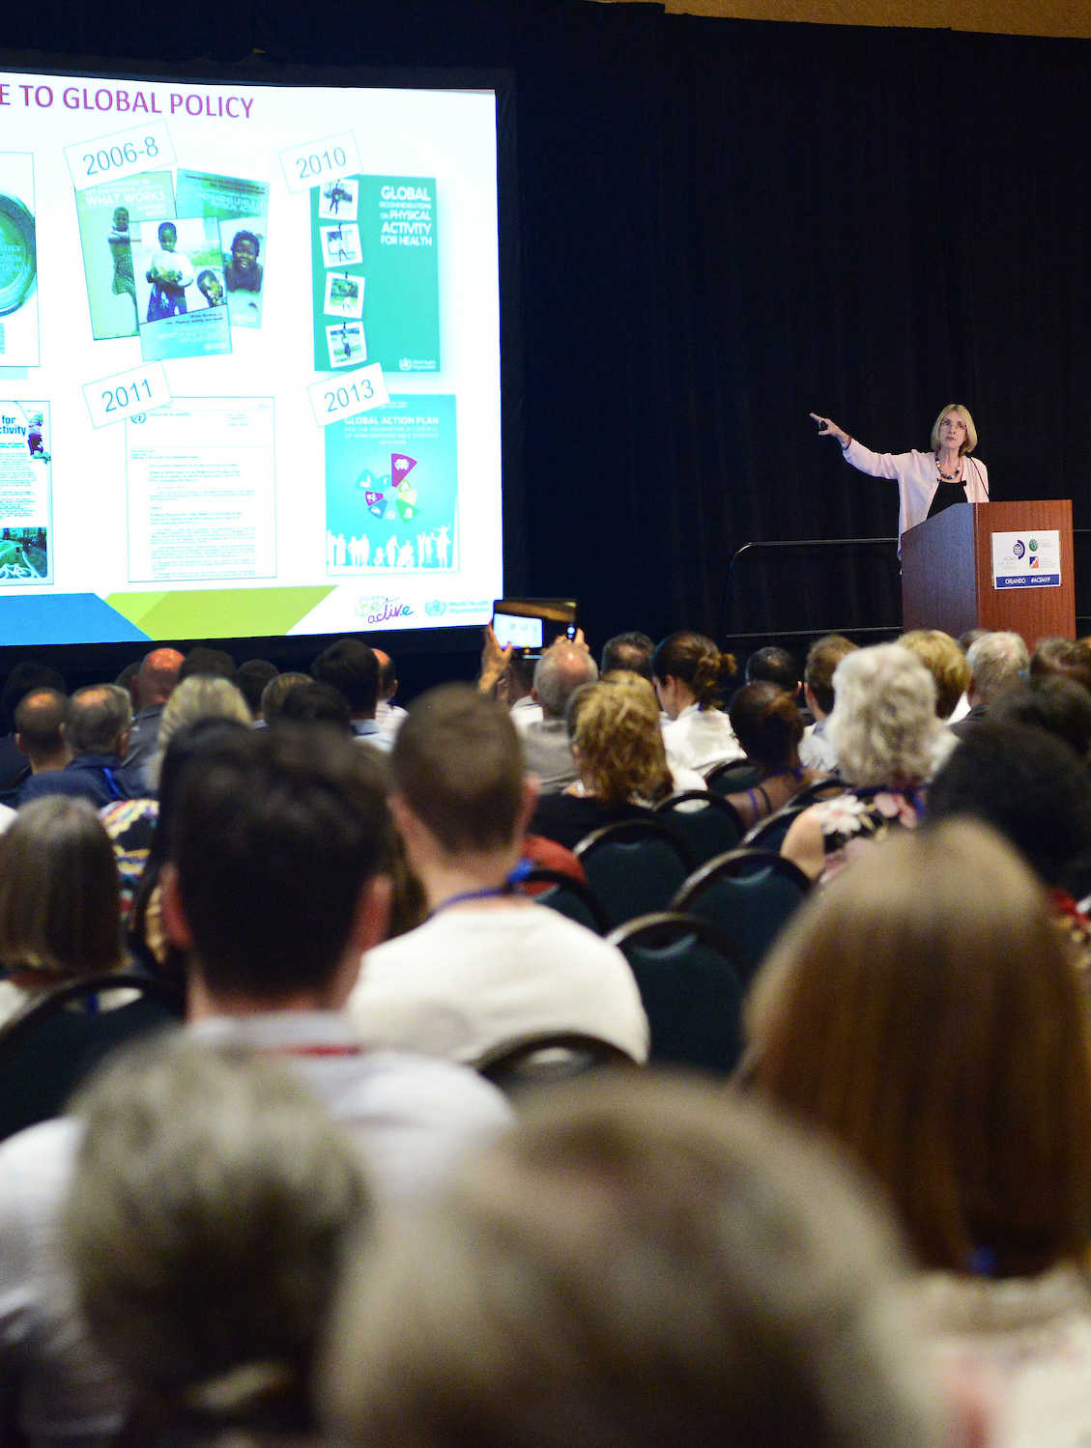
Creating collaborations can be hard to do.
PUSH YOURSELF!
Collaborating is important.
You might be shy or intimidated.
You might not know what to say.
This might be new for you.

Slide 11

BARRIERS TO COLLABORATIONS
Notes:
Ask for a few examples

Slide 12
BARRIERS TO DEVELOPING COLLABORATIONS
Don’t know where to start
Don’t have anything to offer
Resource constraints
Timidity, fear of rejection, time

Slide 13

Colleagueship matters. Creating good relationships beyond your department takes time, effort, and intention.

Slide 14

TIPS FOR ESTABLISHING COLLABORATIONS

Slide 15
THE SEVEN HABITS OF SUCCESSFUL COLLABORATORS
Seek and seize opportunity.
Establish fit.
Pitch perfectly.
Add value.
Keep promises.
Act with integrity.
Be a pleasure to deal with.

Slide 16
“But, how do I find people to collaborate with?”
“How do I learn about funding?”

Slide 17
Finding Collaborators https://discover-research.northeastern.edu/dashboard

Slide 18
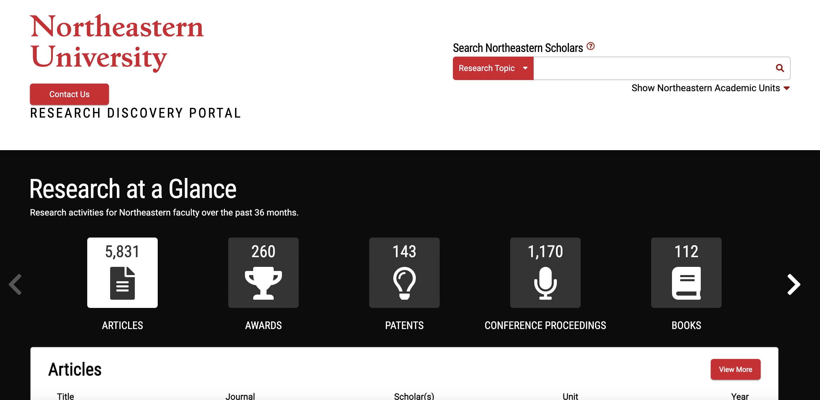

Slide 19
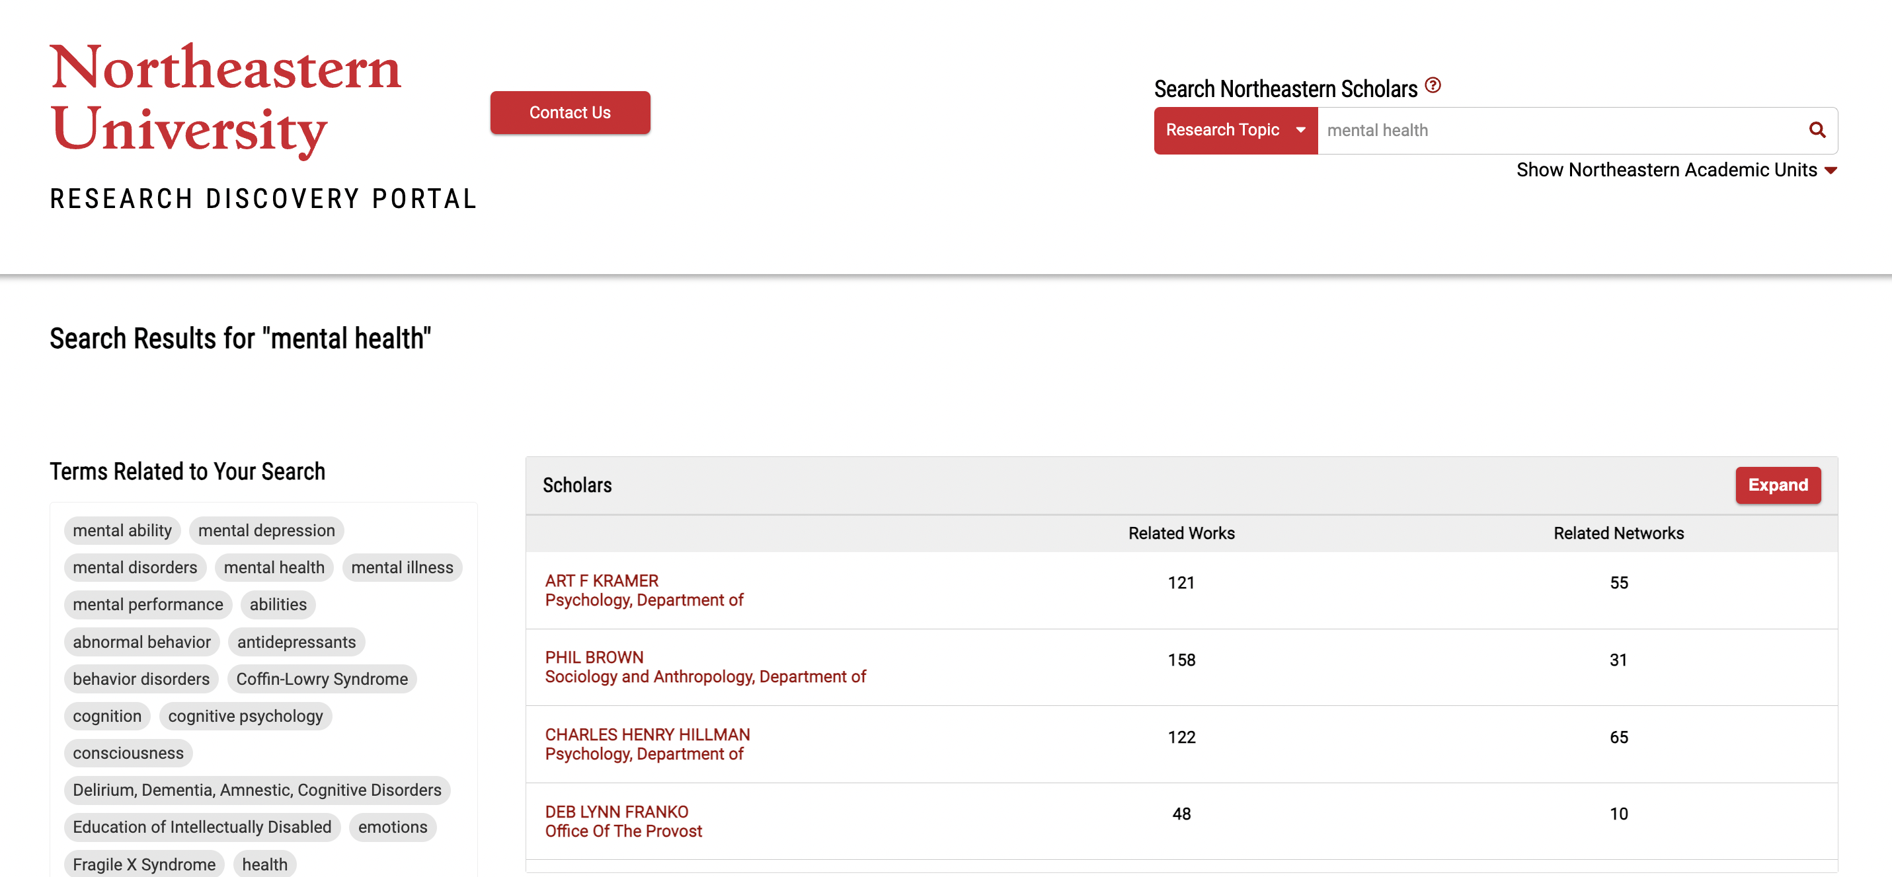

Slide 20
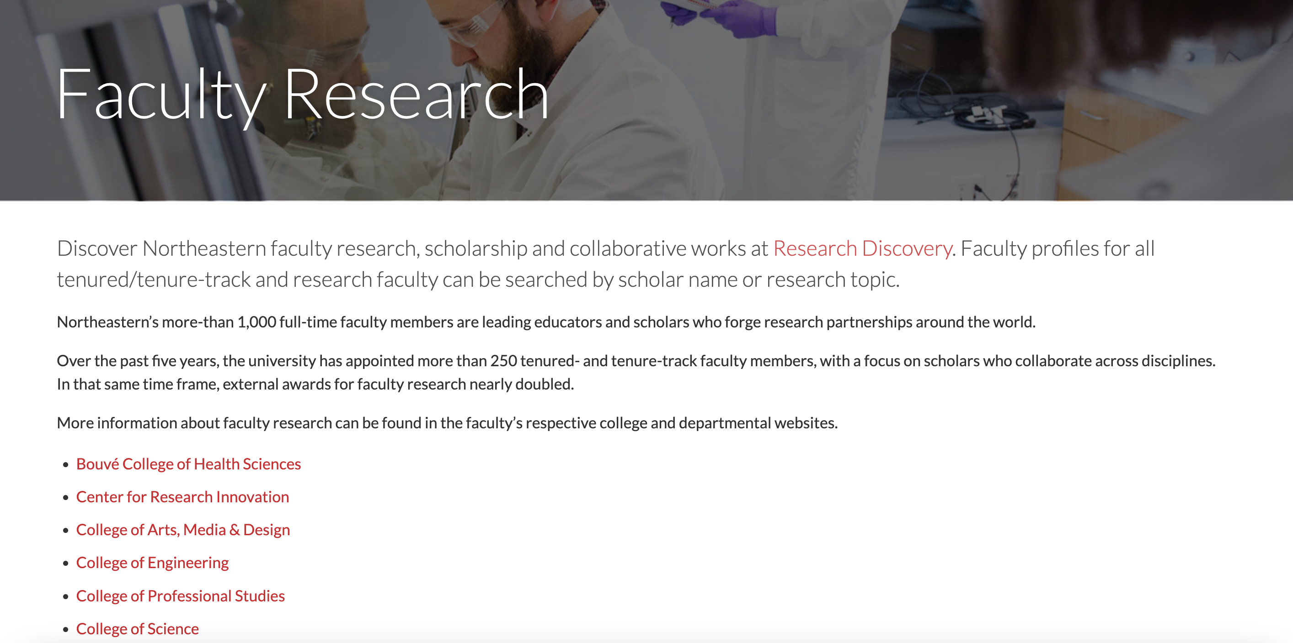
Learning about the colleges

Slide 21
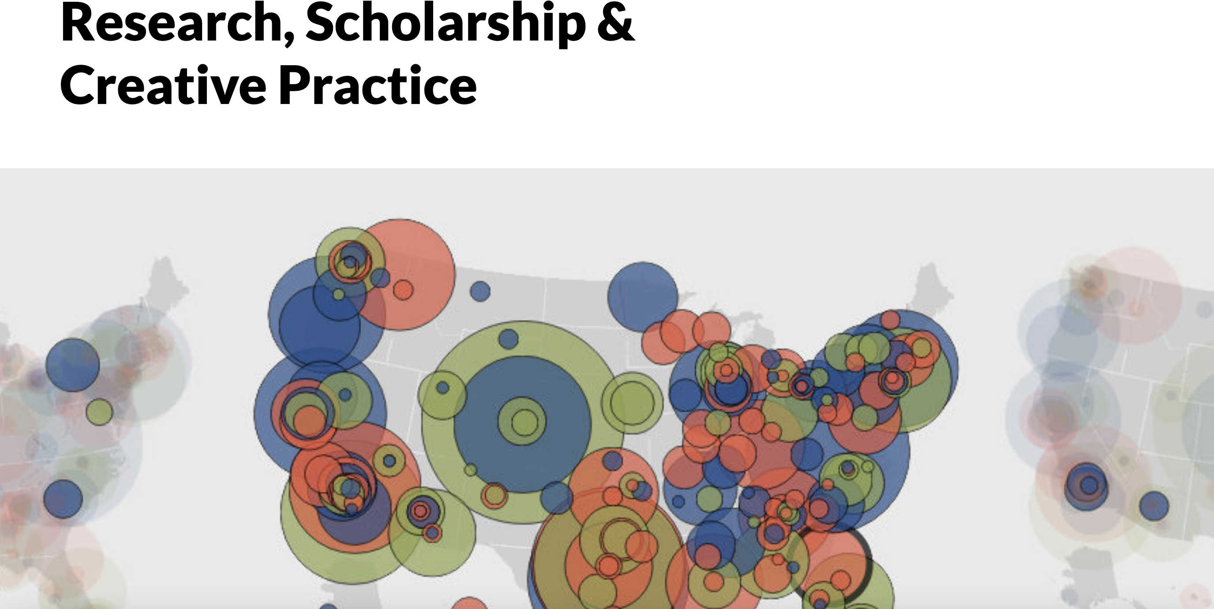
College of Arts, Media and Design:

Slide 22
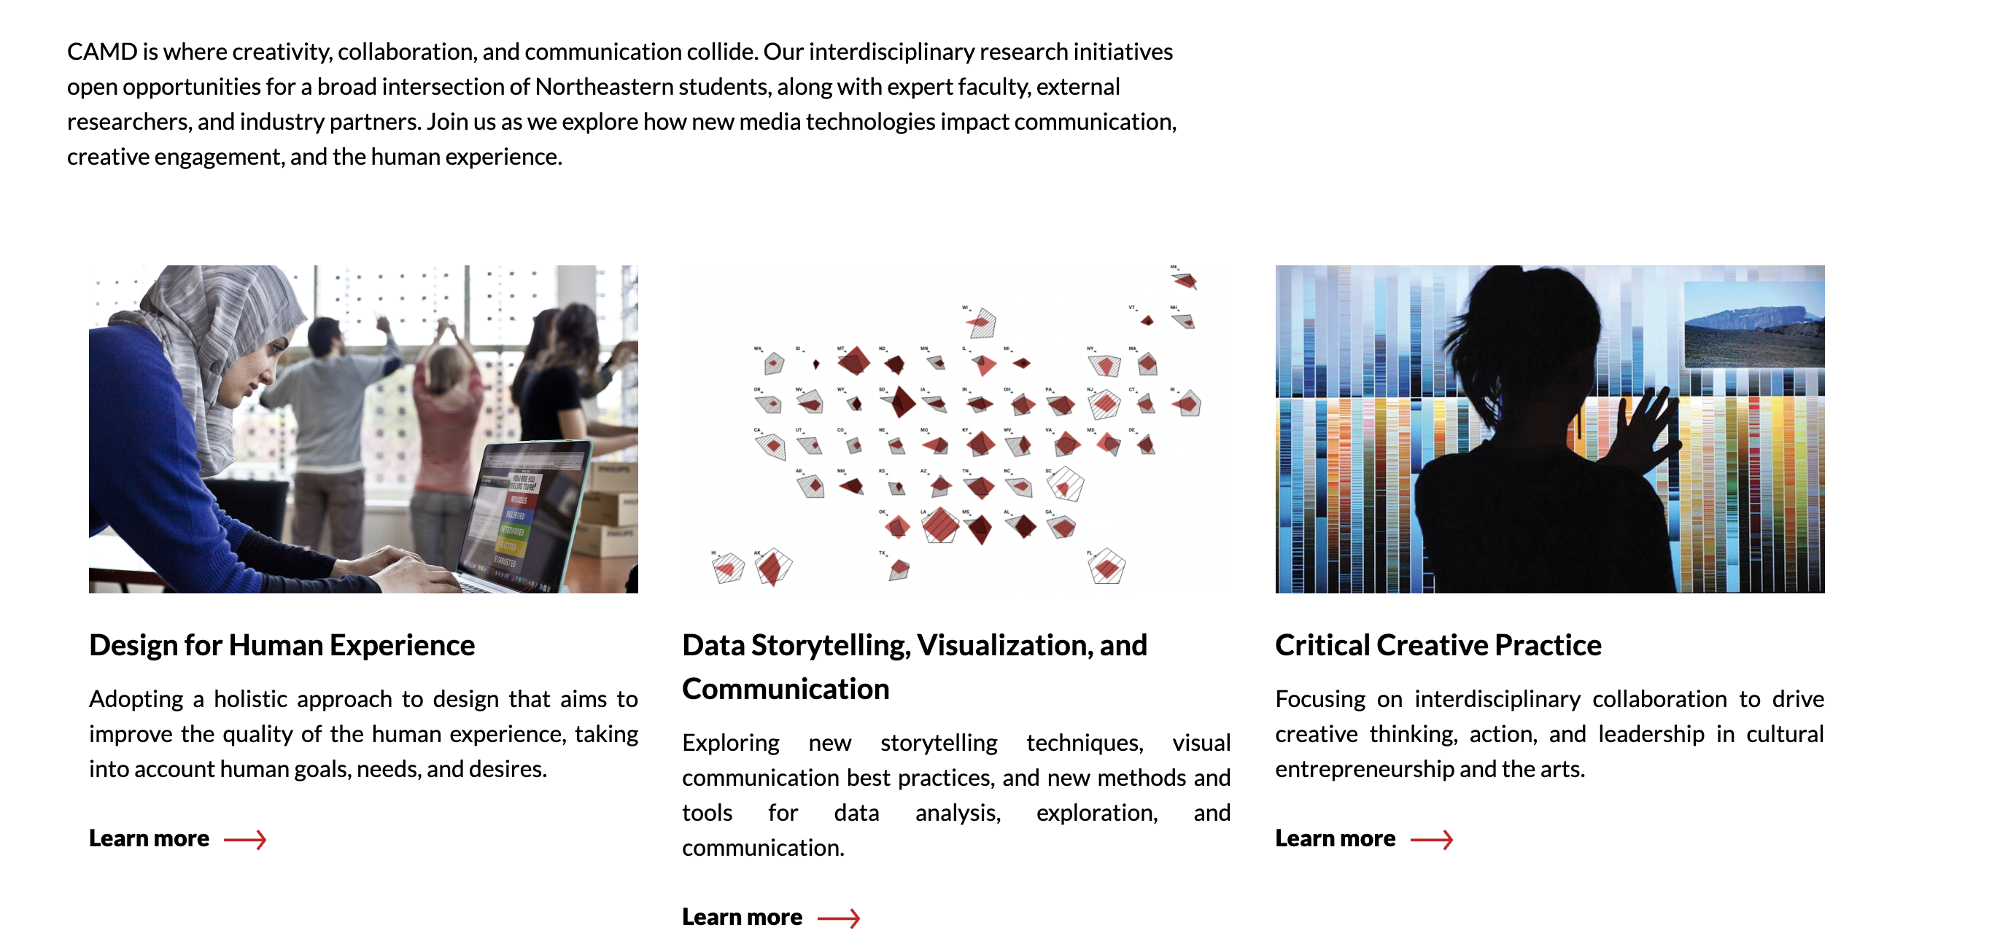

Slide 23
Ways to develop cross-college collaborations

Slide 24

Tip #1: Figure out what you want – and why. Find the right balance for you.

Slide 25
Tip #2: Colleagueship matters. Find colleagues you want to collaborate with. Meet with them. Tell them what you have to offer. Relationships are the key to cross-college collaborations.

Slide 26
Tip #3: Get involved at the university in a bigger way. Figure out what is visible and impactful.

Slide 27

Tip #4: Mentors matter. Find them. Use them. Experienced mentors are great ---- and so are those with recent success. (Also, don’t wear heels when climbing your career ladder…..)

Slide 28

Tip #5: Connect with those who make decisions. When looking for cross-college collaborations, the dean’s leadership team are people to know.

Slide 29
Opportunities for Professional Development
(which can lead to cross-college collaborations)

Slide 30
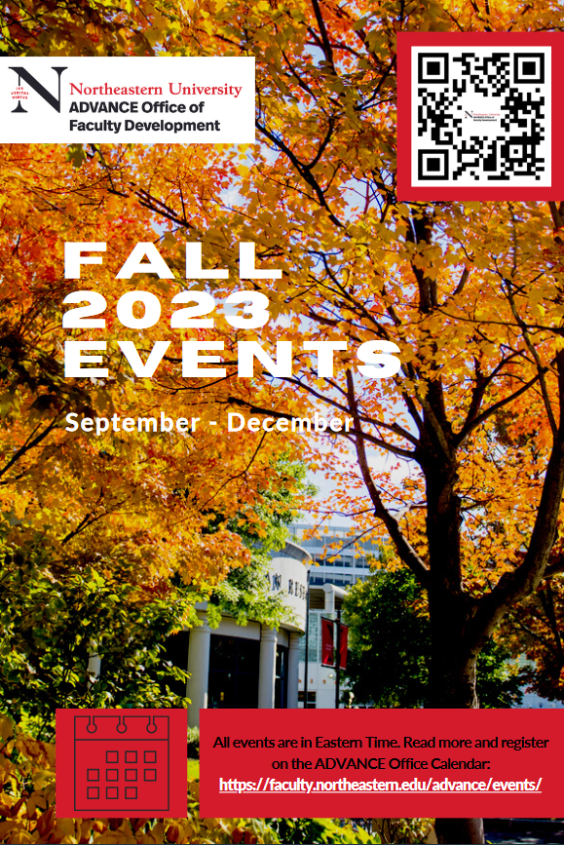
ADVANCE Fall 2023 Calendar
  https://faculty.northeastern.edu/app/uploads/sites/5/2023/08/Fall-2023-ADVANCE-Office-Programming-Hyperlink.pdf
  Faculty Development Workshop with Rebecca Pope-Ruark:
  “Burnout Resilience in Challenging Times” [Hybrid Event] – November 3, 2023.

Slide 31
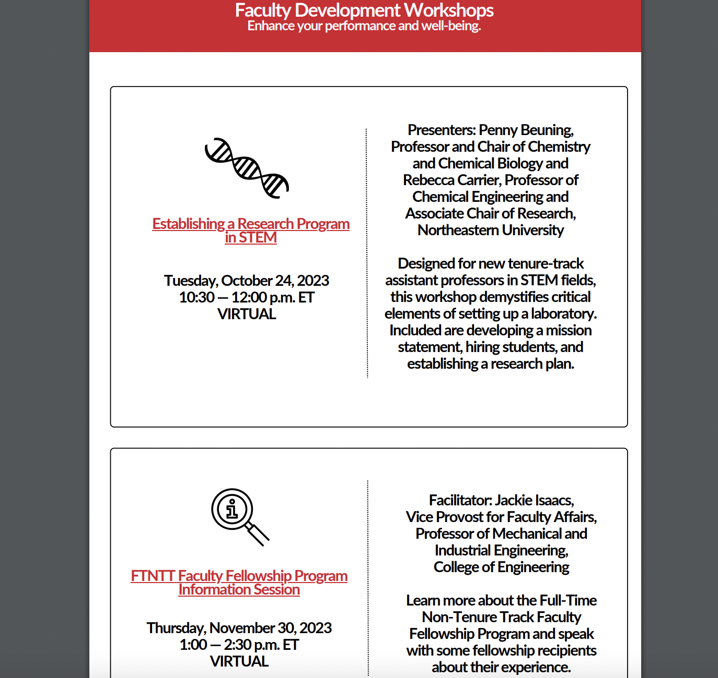

Slide 32
FTNTT FACULTY FELLOWSHIPS
One semester away from the university
Paid
FTNTT faculty eligible once at the “Associate” level
Submit proposal related to teaching at the university
Criteria and how to apply can be found here:
http://provost.northeastern.edu/academics/academic-faculty-affairs/

Slide 33
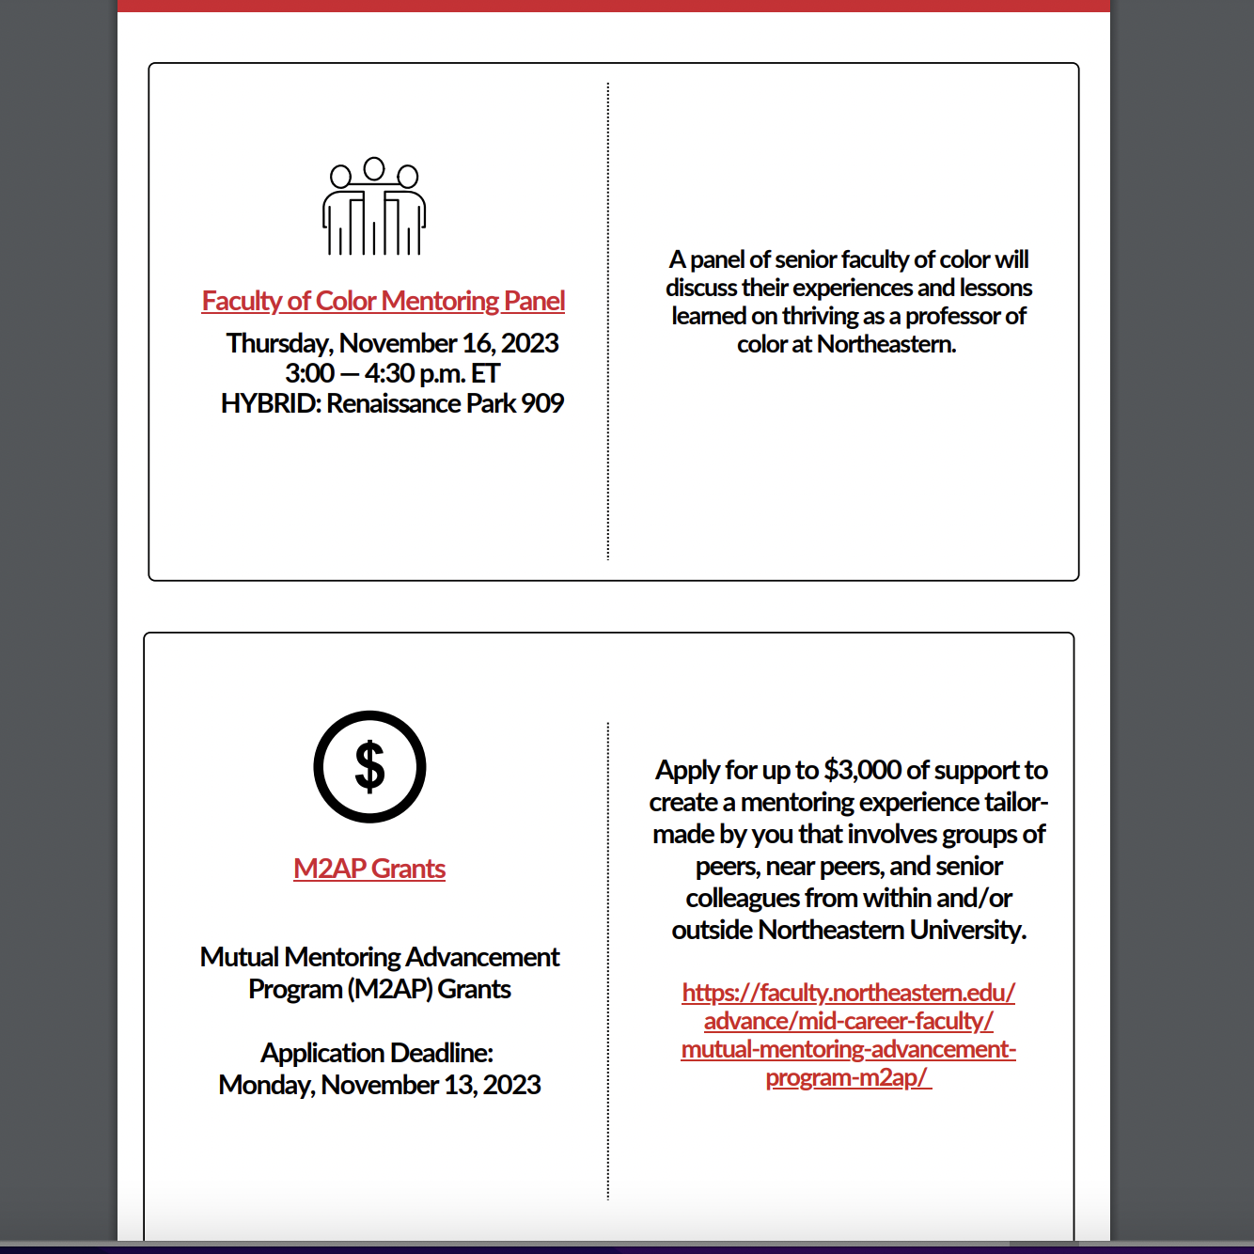

Slide 34
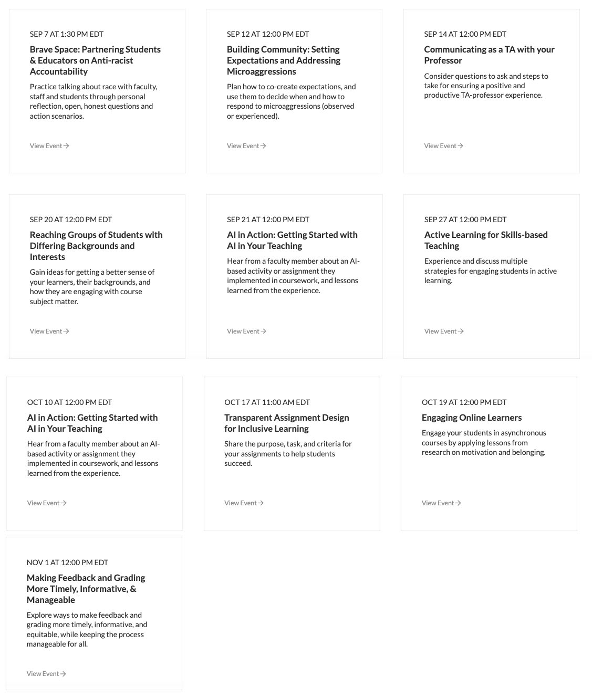

CATLR Opportunities
Faculty-to-faculty connections
across our regional campuses for
pedagogical purposes
Workshops, inquiry groups, cohort programs
All virtual, most timed with Network time zones in mind
https://learning.northeastern.edu/events

Slide 35

“Implementing Industry Projects in Class (XN)”
10/23, 10:00-11:30 and 4:00-5:00 PT in Seattle and Online
Get ideas for how to create challenging and engaging course assignments that engage students in real world work with industry partners.

Slide 36
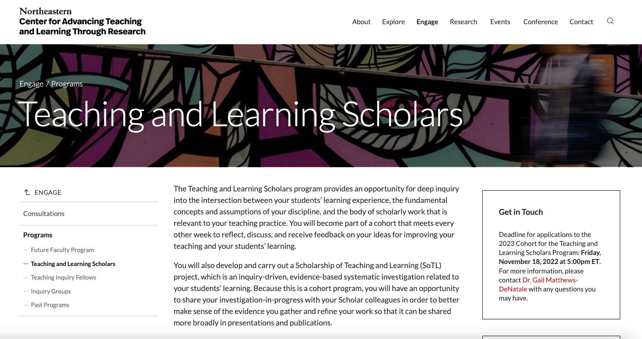


CATLR Opportunities
Faculty cross-college collaborations
Research collaboration in the network
SoTL Cohort Programs (application only)
Especially valuable for Teaching Faculty (e.g., scholarly activity, promotion)
https://learning.northeastern.edu/engage/programs/scholars-program

Slide 37
Professional Development Funding
FTNTT Professional Development Awards ($2000/every other year)
Mutual Mentoring Grants (ADVANCE)
Inclusive Impact Innovation Funds (ODEI)
Tier 1 Research Funding (NURES)
Impact Engines (Provost’s Office)
Call for new Humanics courses (Uta Poiger)
Fellowships around the university (Humanities Center, IHESJR, CATLR)

Slide 38

To summarize today’s talk:
There are many professional development opportunities around Northeastern. Important to create a plan best for you.
Cross-college collaborations are encouraged.
Getting involved by connecting with others, including leaders, is key.

Slide 39
Thank you!
Questions?

