Slide 1
Faculty Research Collaborations: Finding People and Finding Funds
Deb Franko
Senior Vice Provost for Academic Affairs
October 8, 2024

Slide 2
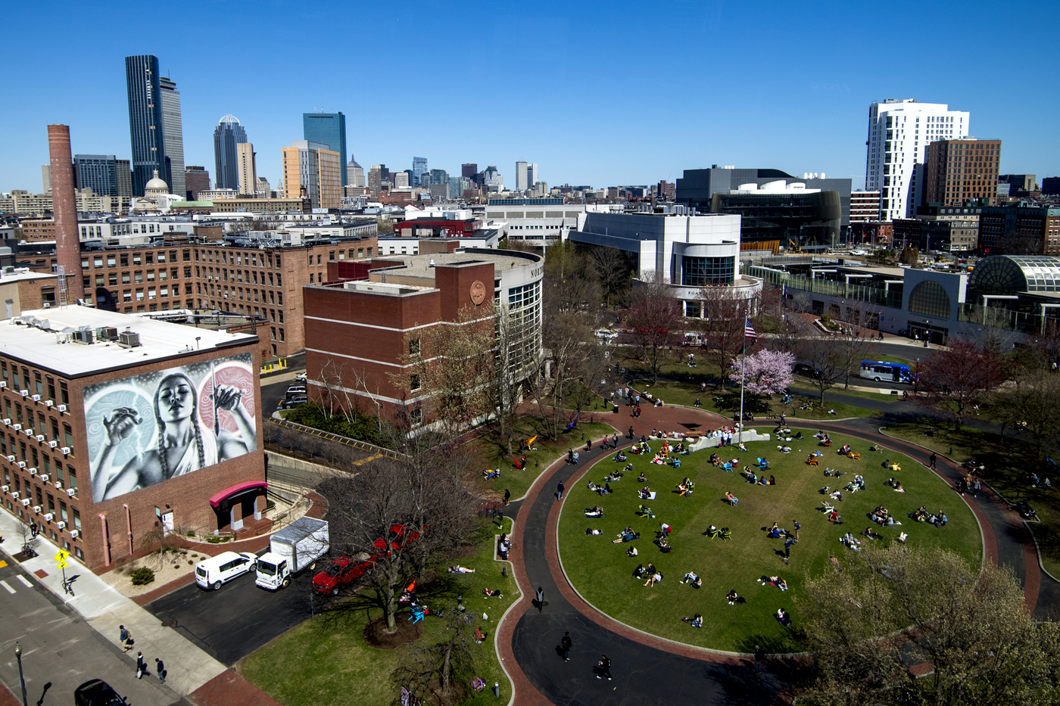
Northeastern is a big place.
It takes time to get to know the people here.

Slide 3
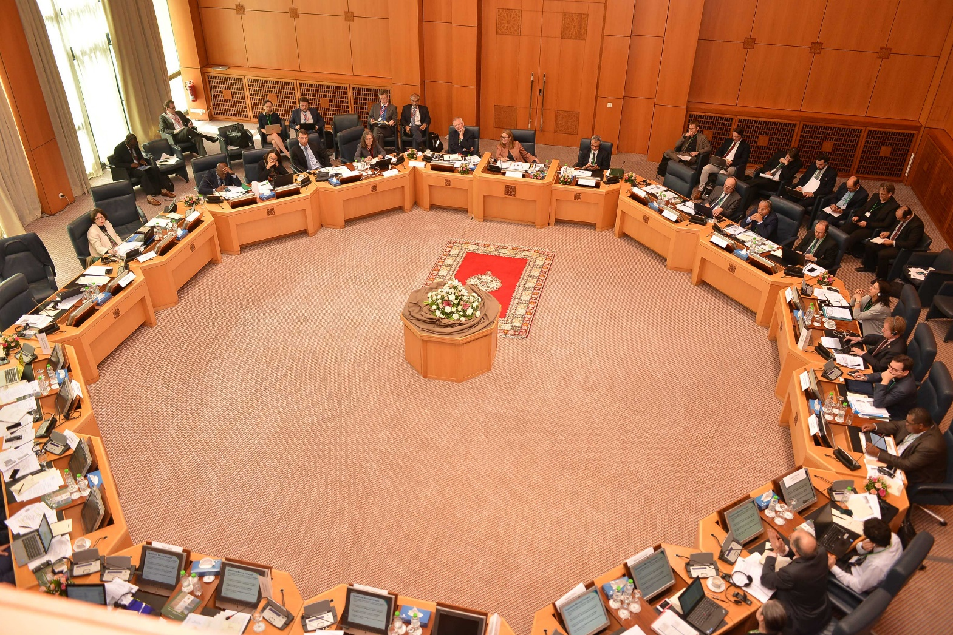
Finding collaborators and working together also takes time.

Slide 4

Experience Unleashed
Activate the Global
University
System
Personalized, experiential
learning
High Impact
Research
Diversity, Equity
and Inclusion
Technology and
Service Excellence
Notes:
David Madigan
We will:
Focus on diversity and inclusion in every context
Wholly immerse learning and discovery in experience, untethered from the disciplinary boundaries
Build interdisciplinary clusters of partners, faculty, staff and students around specific real-world challenges. We call these impact engines
Go to world. We will build out a truly global university and aspire to total mobility
Empower this vision and scale and service excellence through technology
Commitment to sustainability throughout the curriculum…

Slide 5
“Forging Connections and Finding Collaborators”

Slide 6

Colleagueship matters
Creating good relationships beyond your department takes time, effort, and intention.

Slide 7

Reflection
Past collaborations?
What worked? What didn’t?
How did you find your collaborator(s)?
Funded?
How?
If not, what have you tried?
What gets in your way?
What makes it hard?

Slide 8
Reflection
Collaborators? Who.
Funding?
Where.
Think carefully about your research and what you need to be successful.
More time—How to find?
Goals and a plan?
Mentor?
All of the above?

Slide 9
Self-Assessment
Your research interests
Take the time
Search widely
University resources
Use them
Your pitch
Write ‘proposal’
Email/phone/meet

Slide 10
Funding Search
Key Questions
Match question to $
Search widely
University Resources
This takes time
Your pitch to the funder
Write proposal
Others review

Slide 11

BARRIERS TO RESEARCH COLLABORATIONS
Notes:
Ask for a few examples

Slide 12
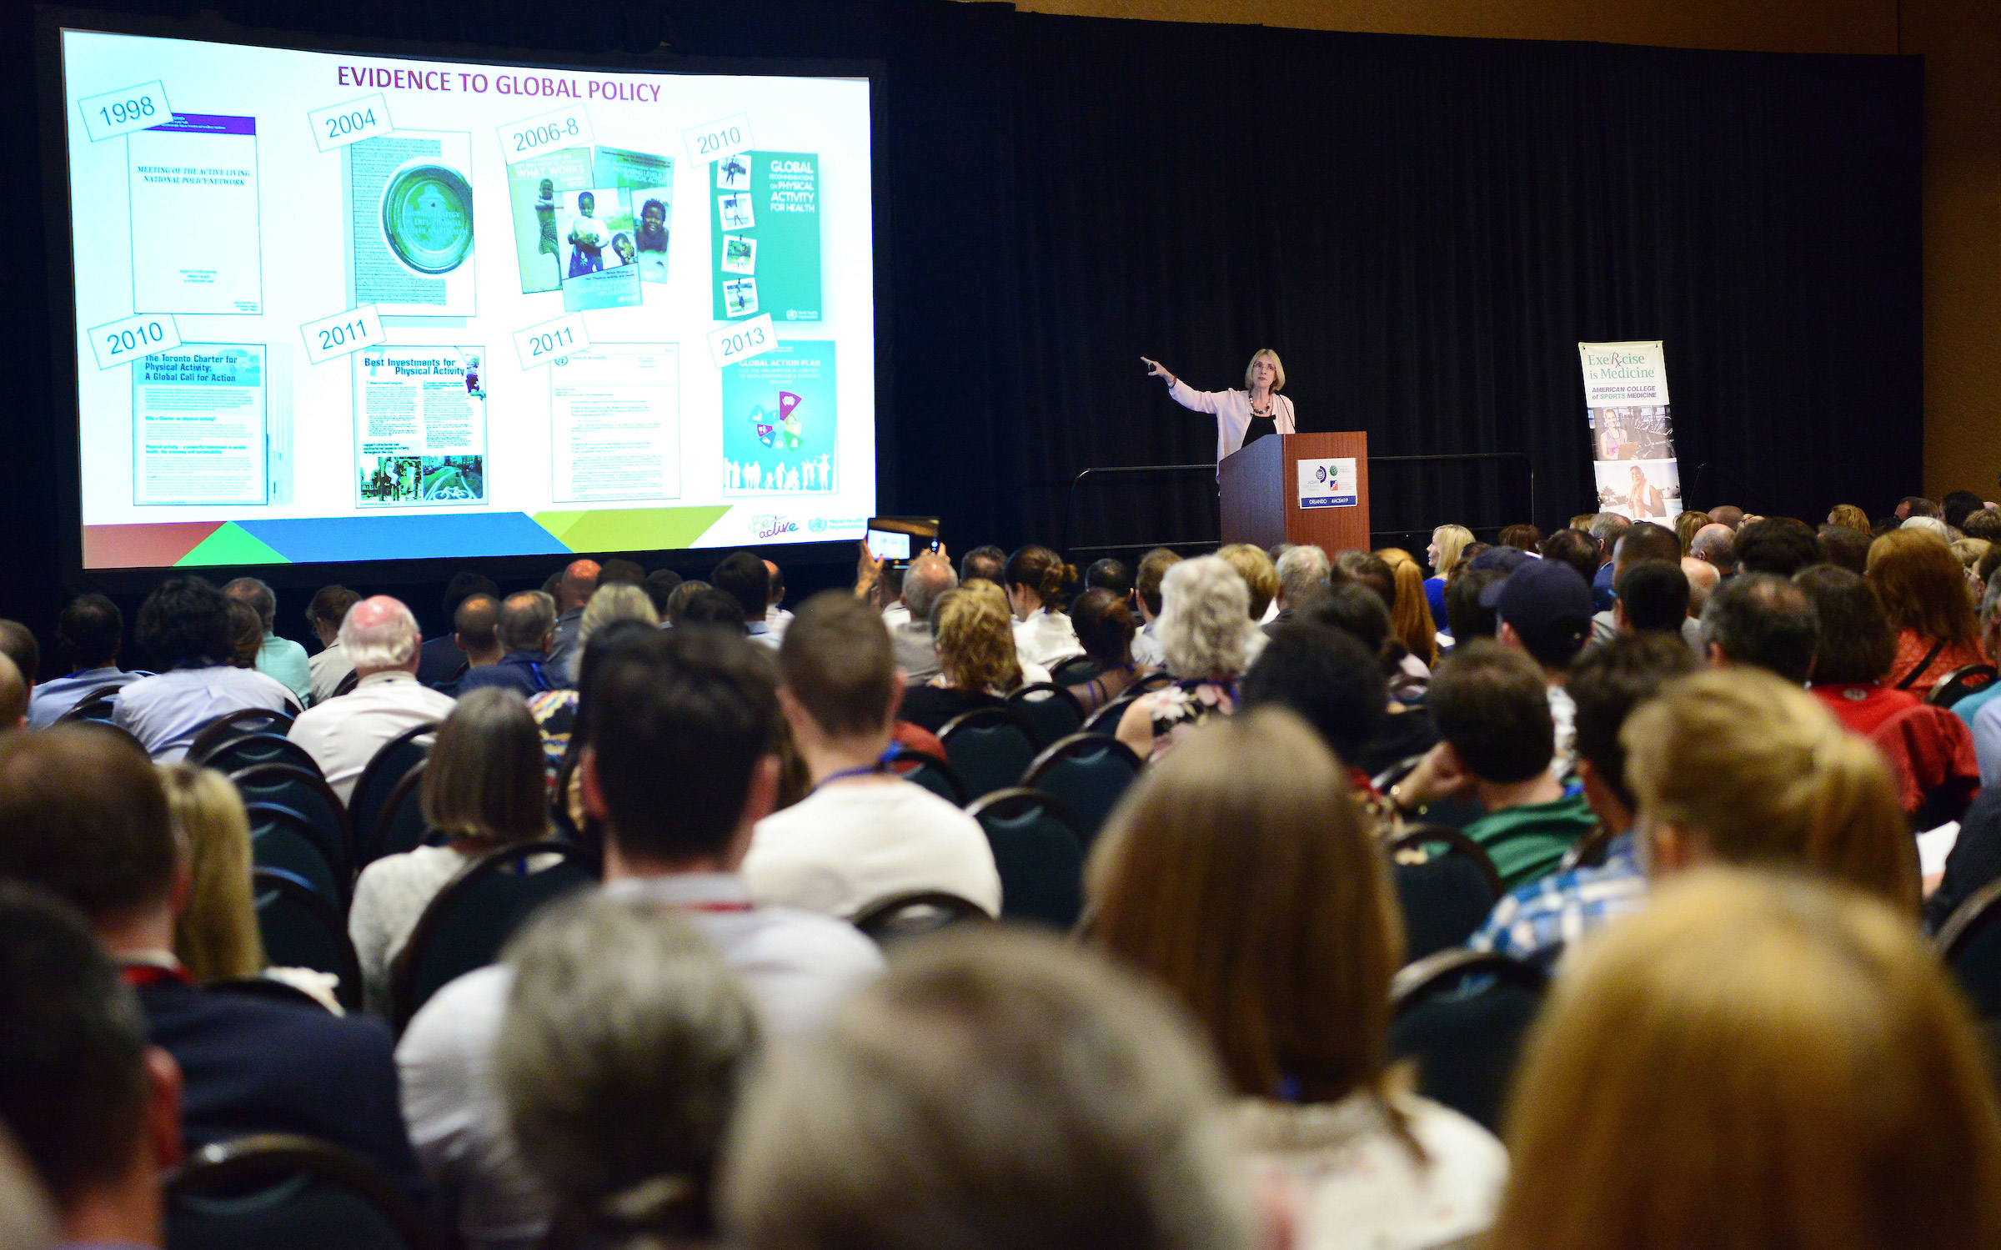
What makes this hard?
Don’t know where to start
Not sure what have to offer
Resource constraints
Shy, fear of rejection
Takes time
PUSH YOURSELF!

Slide 13

TIPS FOR ESTABLISHING RESEARCH COLLABORATIONS

Slide 14



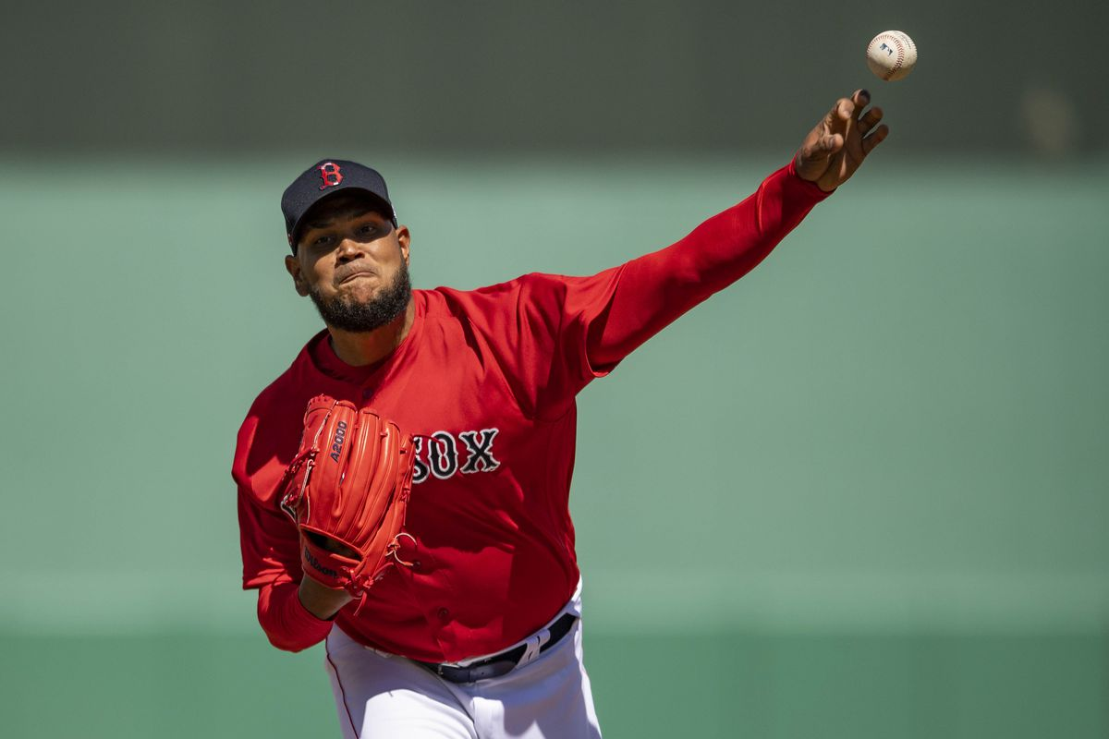



Seven Habits of Successful Collaborators
Seek and seize opportunity
Establish fit
Pitch perfectly
Add value
Keep promises
Act with integrity
Be a pleasure to work with.

Slide 15
“But, how do I find people to collaborate with?”
“How do I learn about funding?”

Slide 16

Tools

Slide 17
Finding Collaborators https://discover-research.northeastern.edu/dashboard

Slide 18
*New* Collaboration Series for AY24-25: Destination Collaboration
Virtual faculty networking events in AY24-25 designed to uncover potential cross-college collaborations in strategic areas
Goal: To seed interdisciplinary research connections.
Faculty will have the opportunity to present a 2-minute “give/get” slide to introduce their work and identify the expertise they are seeking in a collaborator.
The events will be recorded and will serve as a compendium of the research interests of colleagues for subsequent consultation.

Slide 19
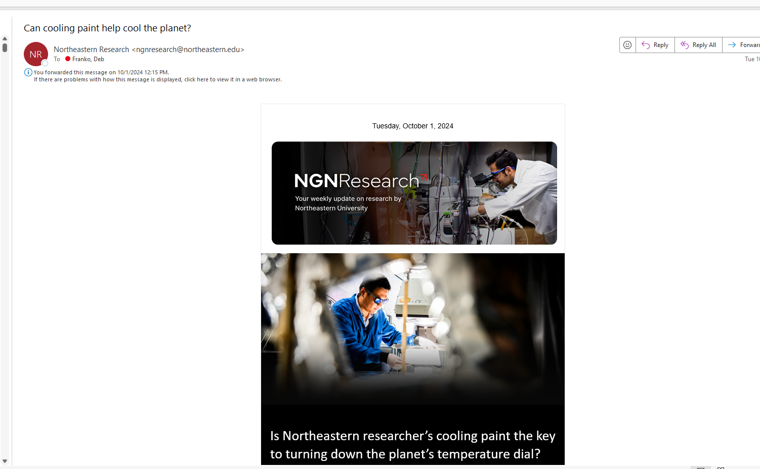

Slide 20
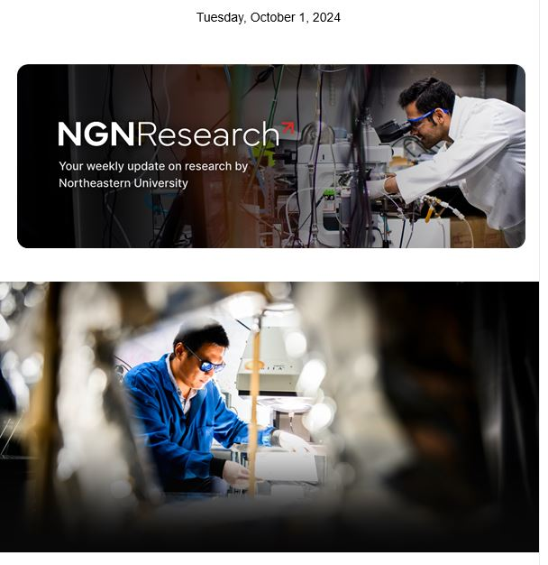
Microsoft Outlook Newsletter
From: Northeastern Research <ngnresearch@northeastern.edu>
Sent: Tuesday, October 1, 2024 10:01 AM
Subject: Can cooling paint help cool the planet?

Slide 21
Is cooling paint the key to turning down the planet’s temperature dial?
Professor Yi Zheng, Associate Professor, Mechanical and Industrial Engineering
Breakthrough 3D imaging to detect lung cancer early developed by Northeastern researcher
Professor Soner Sonmezoglu, Assistant Professor, Electrical and Computer Engineering
Queer tabletop roleplaying games provide valuable lessons that even ‘Dungeons & Dragons’ can learn from, new research finds
Professor Alexandra To, Assistant Professor, Art + Design

Slide 22

Book Highlight
‘Under a Zambian Tree: Dora Moono Nyambe's quest to educate her nation’
“Under a Zambian Tree” tells the inspiring story of Dora Moono Nyambe, or “Teacher Dora,” who transforms a rural village in Zambia through education and empowerment.
Her journey, supported by millions online, highlights the power of kindness and resilience, and encourages readers to realize that they too can create positive change in their communities, no matter how small their actions may seem.
Joseph Schmitt, 2023
Published by Great Lakes Publishing

Slide 23
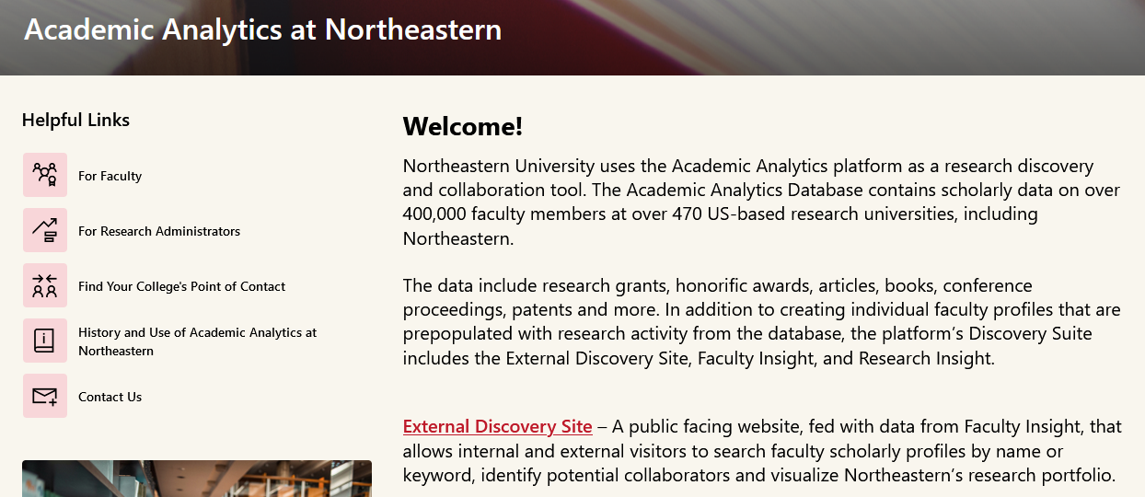
https://northeastern.sharepoint.com/sites/AcademicAnalyticsNU

Slide 24
Range of AcAn Tools
Finding research collaborators
Locating “experts” for news stories
Determining faculty nomination readiness
Exploring candidates for faculty searches
Benchmarking departments
NOTE: Only T/TT faculty have profiles; must be requested for other faculty

Slide 25
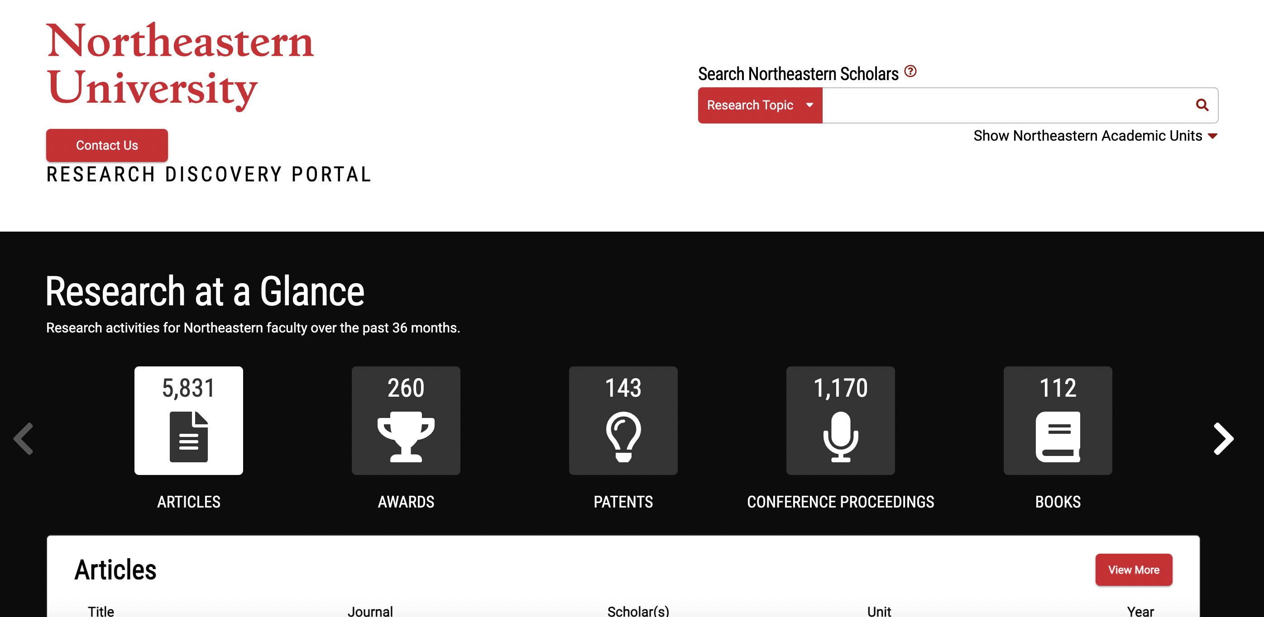

Slide 26
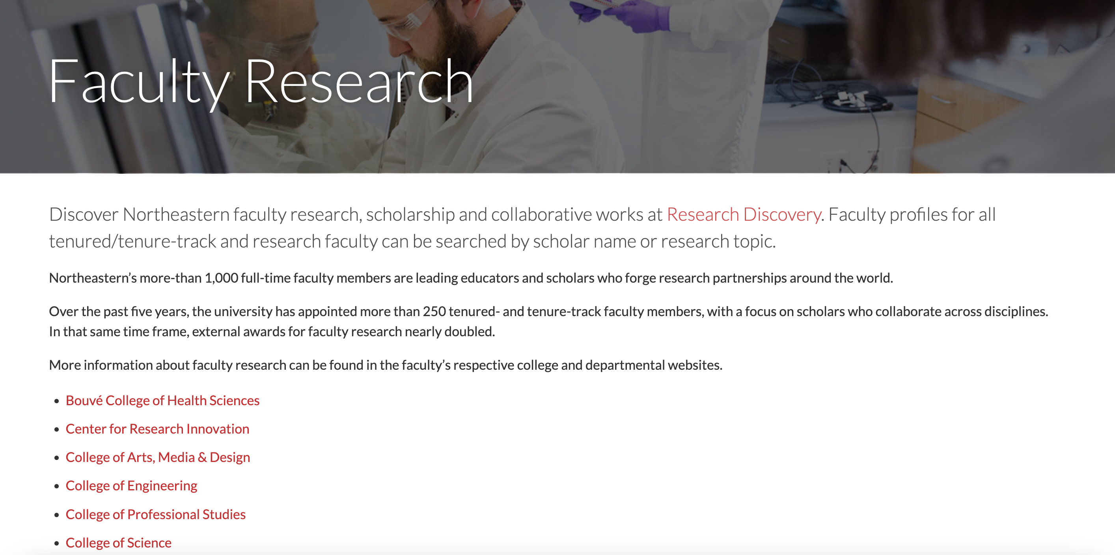
Another way to find collaborators in research

Slide 27

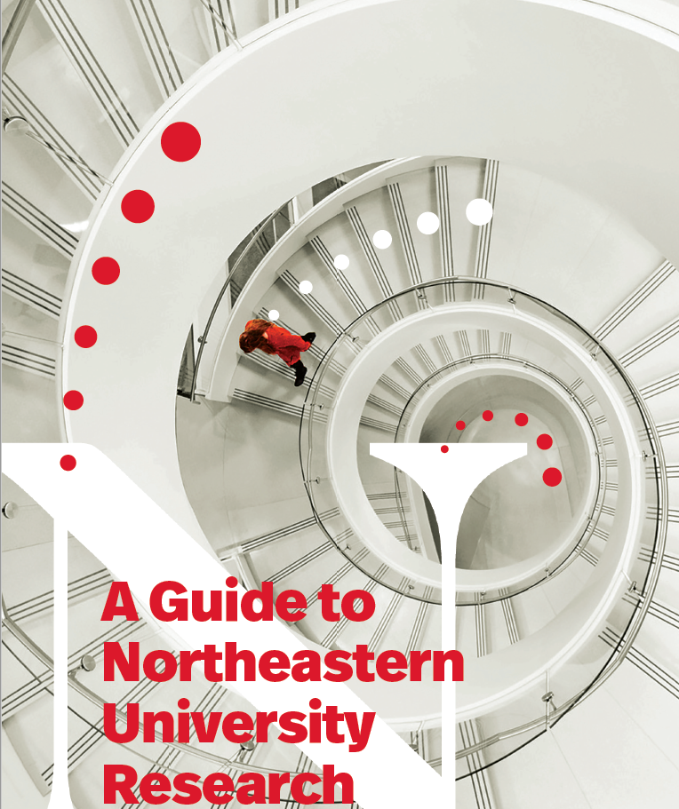

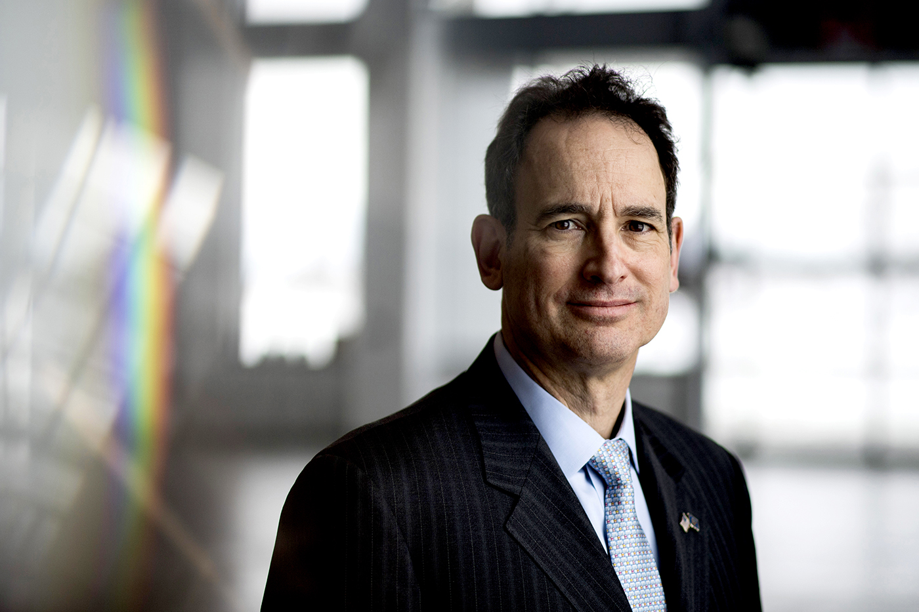
Research Division
Research Development is your friend!
Focus on research excellence and strategic
research initiatives and the Academic Plan
David Luzzi, Ph.D.
Senior Vice Provost for Research at Northeastern

Slide 28
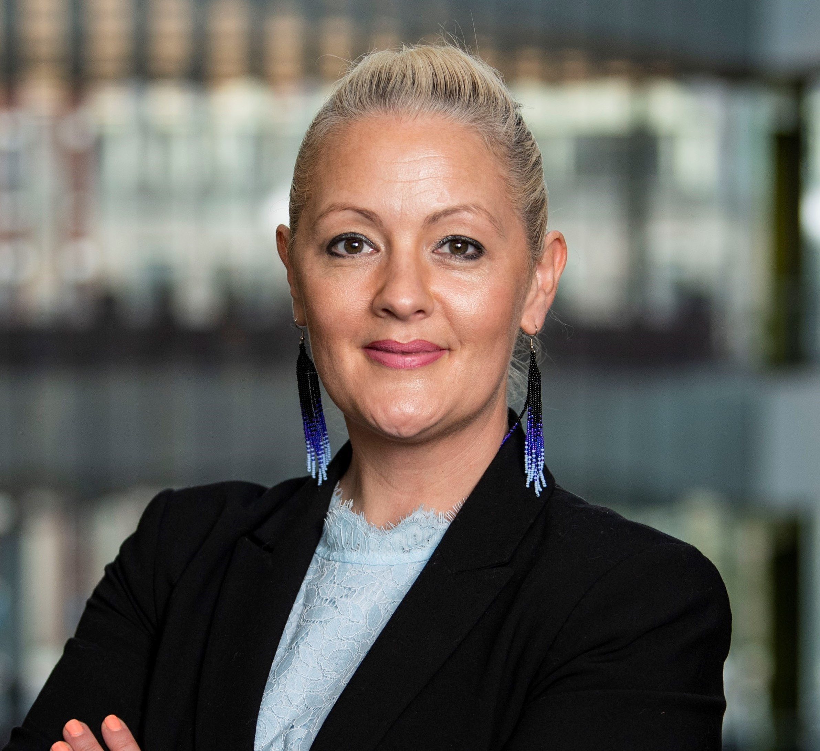
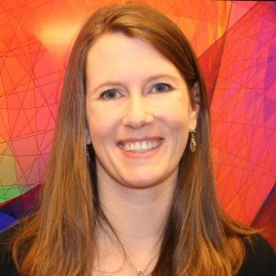
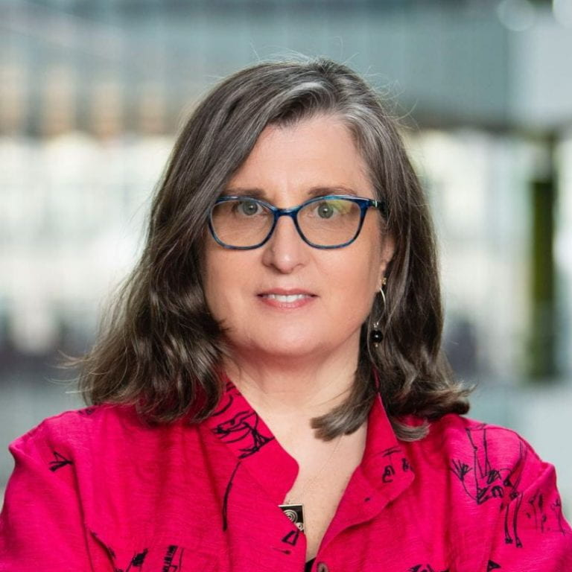
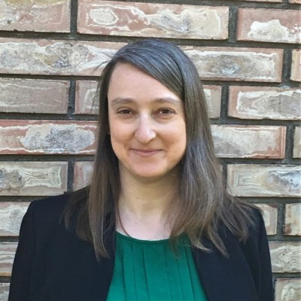
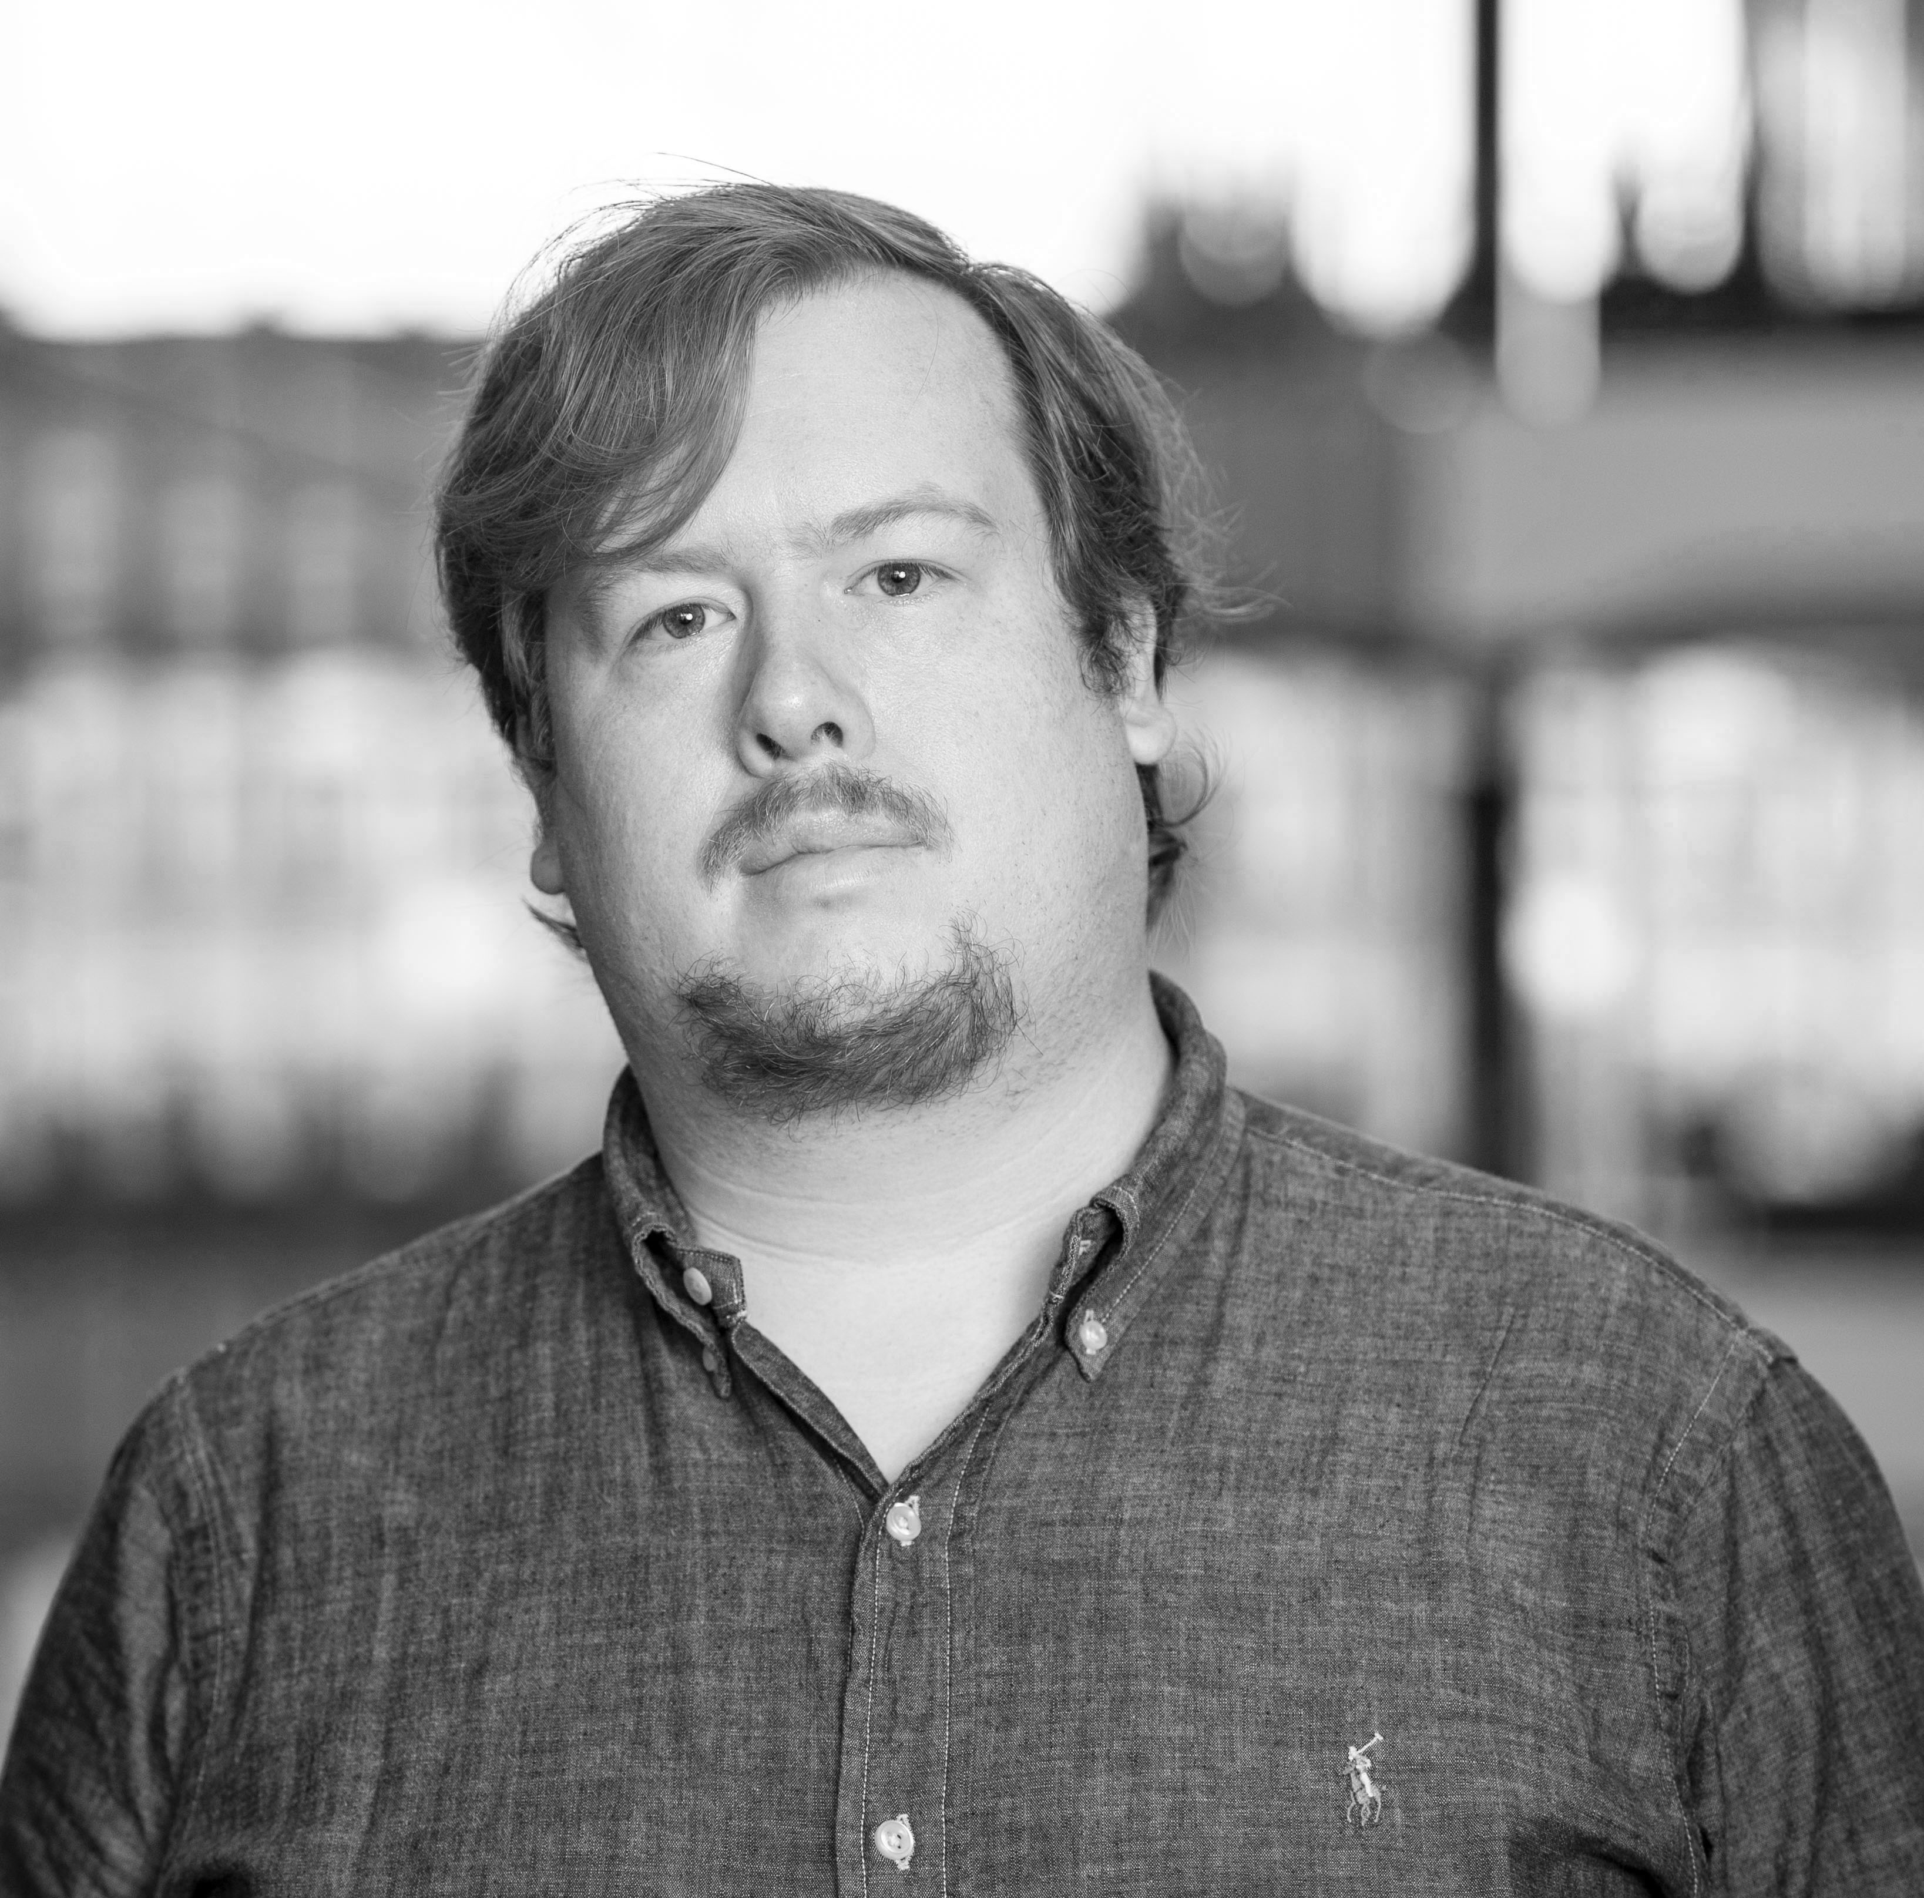

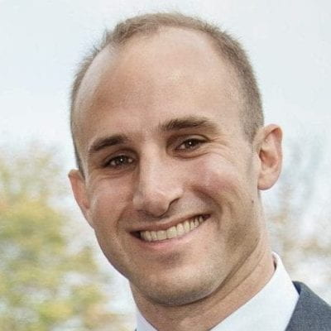
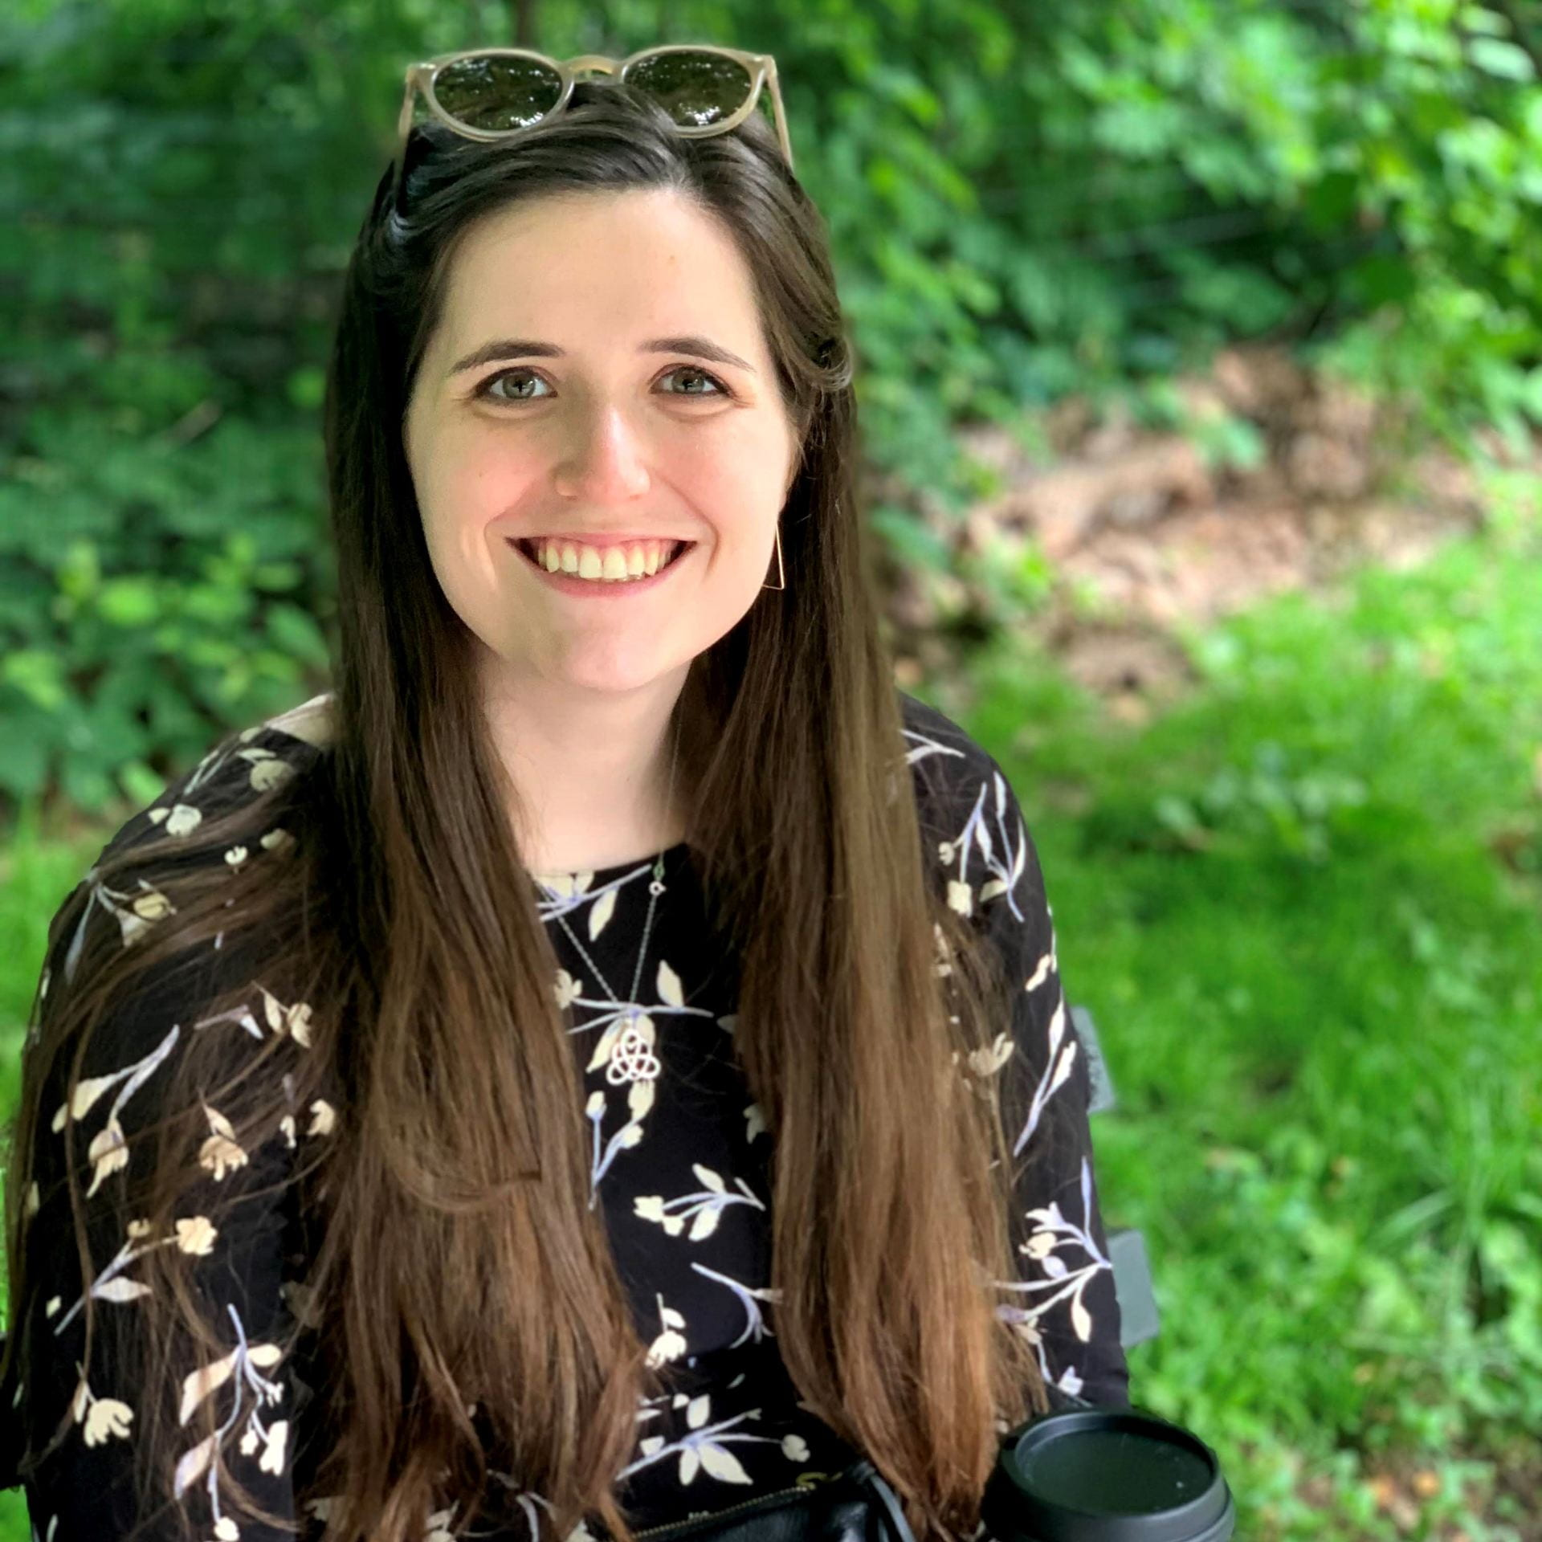
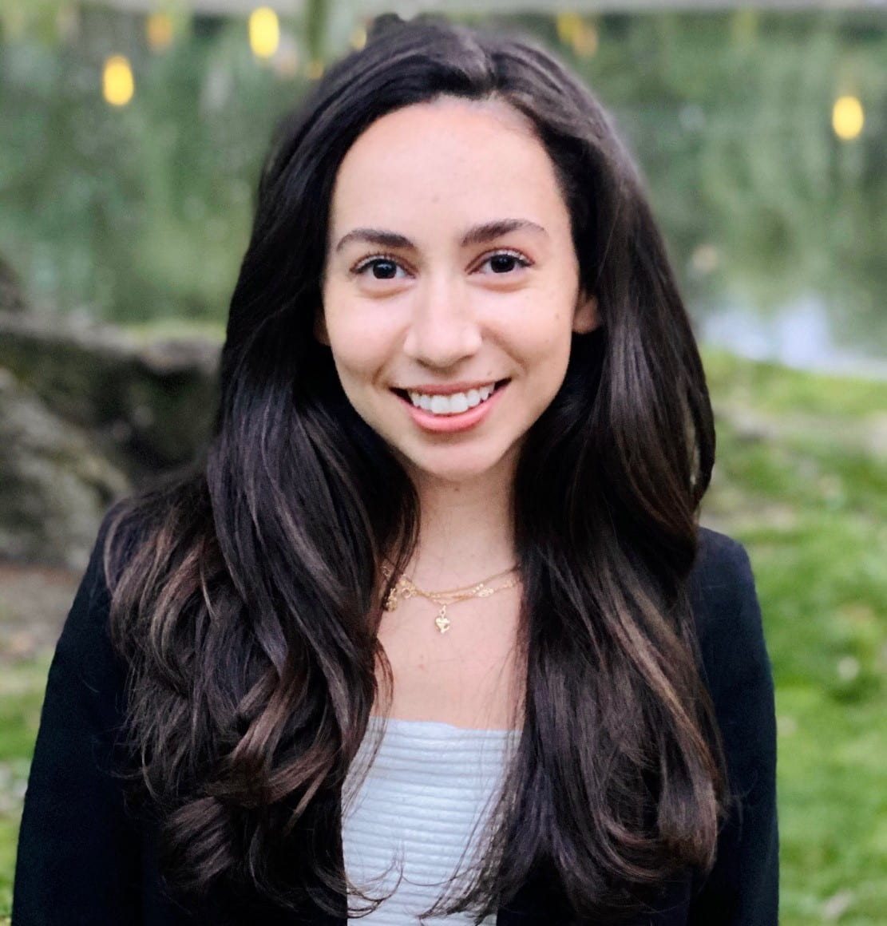
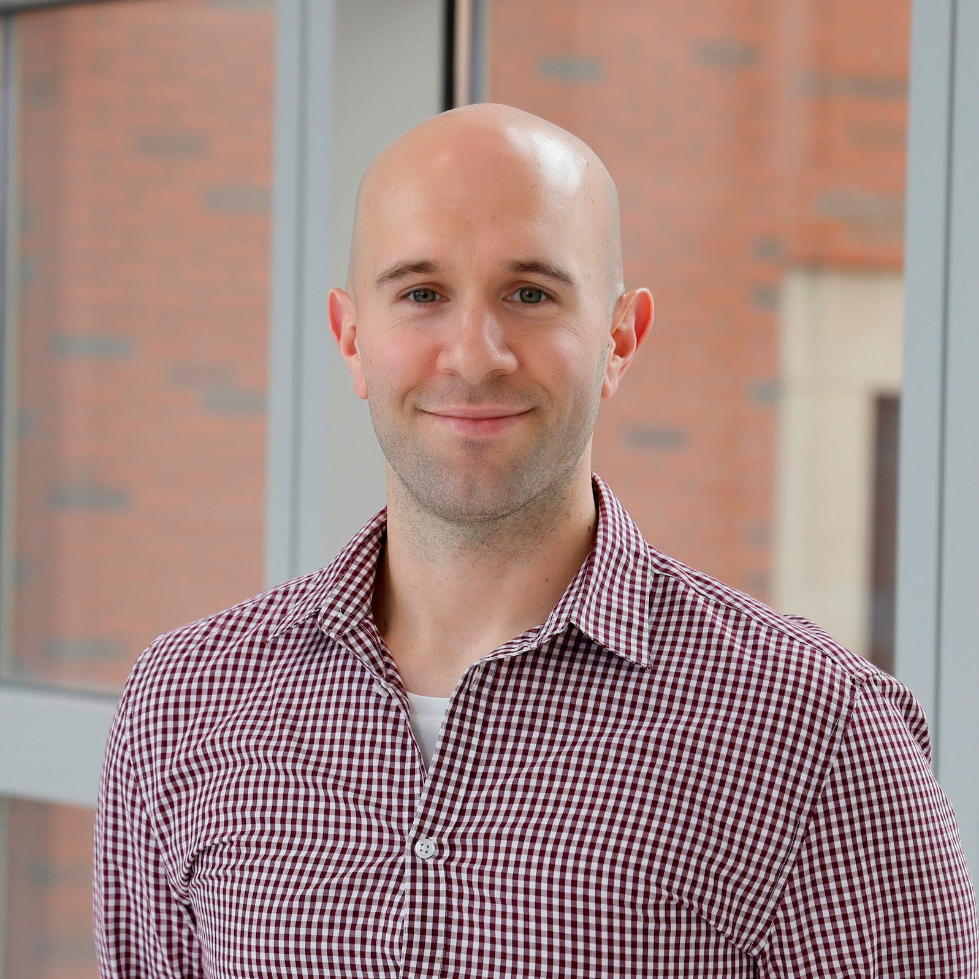
Research Development: Our Team
Research Development (Central team)
Kim Holloway, Ph.D.
Erin Hale
(starts Sept)
Colleges, Large Programs
Trish Curtin
KRI, large programs, partnerships
Crystal Welliver
Global Campuses
Zac Perry, Ph.D.
Institutes, Large Programs
Jenna Horan
Internal Programs
Garrett Morrow, Ph.D.
Limited Submissions
Julia McKay
FOAs/website
Dana DeBari
Government Affairs
Daniel Mueller
DOD/Events
Notes:
These are only the specific RD staff involved- there are also others who are key players in research development at the institution, including your Associate deans for Research, Central Corporate & Foundation Relations, Center for STEM Education, Government Affairs- among others. We as a team also engage heavily with other constituents such as college research administration staff, central research enterprise support (NU-RES) – which can often smooth the path to submission especially for new faculty.

Slide 29
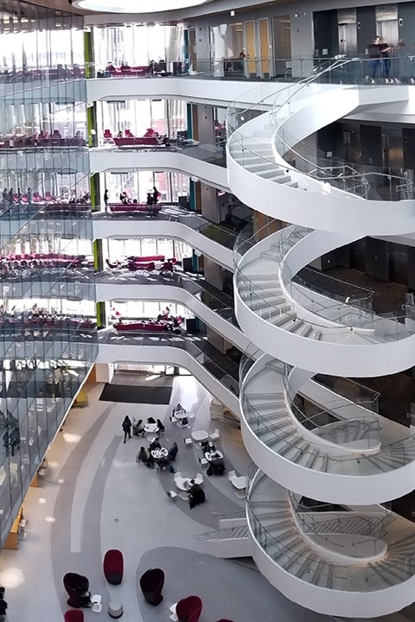
What is Research Development?
“Research-development professionals occupy a unique and valuable role in the academic enterprise. We journey through the campus, traversing it daily in small exploratory ventures or large expeditions, helping people formulate and finance their research and doing what we can to make things a success.”​ Jacob Levin
Chronicle of Higher Ed.
https://resdev.northeastern.edu/about/
Notes:
RD is a set of strategic activities designed to facilitate individual faculty members, teams of researchers and central research administrators in maximizing extramural funding, creating relationships and developing and implementing strategies to increase institutional competitiveness
Note about the hard copy research overview available

Slide 30



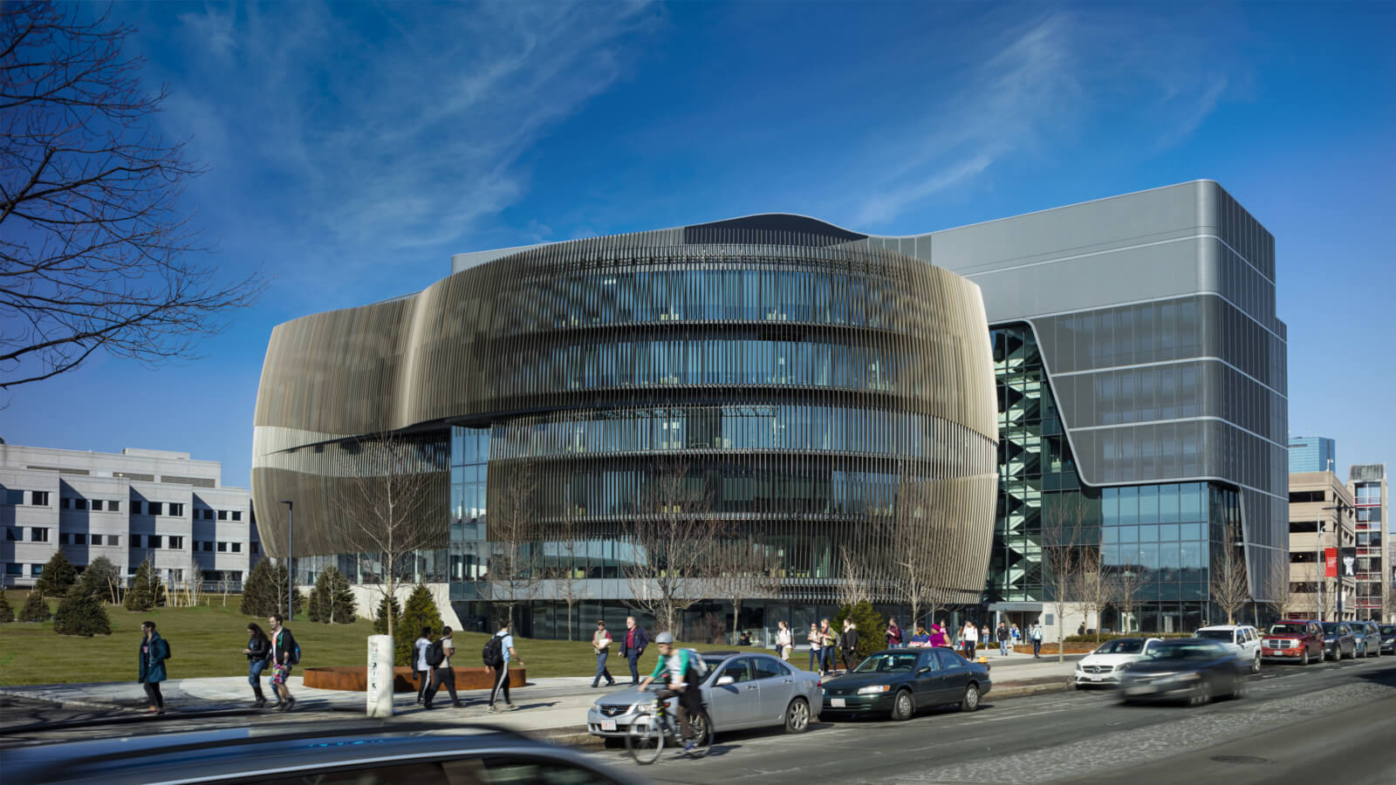
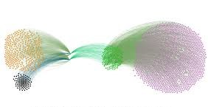

Overview of Research Development
Funding Opportunities
Early Career Faculty Programming
Researcher Positioning
& Teaming
Academic Analytics
Center-scale programs
Limited Submissions
Proposal Development
Notes:
Administer the limited submissions review program- and assist with LS proposal prep
Support team building around topical or strategic themes and connect faculty with funders
Strategic and project management roles on large center proposals- (multi-institutional, multi-disciplinary, >$1M/year)​
Build topical teams
Convene research workshops with industry partners
Promote collaboration with extramural partners (e.g., WHOI, UMaine, UMASS)
Participate in working groups
Advise faculty about collaboration opportunities
For Large, Complex, and Highly Visible Proposals:
Convene faculty around major submission opportunities, both current and anticipated
Organize an internal kickoff meeting to discuss administrative support (Timeline, FOA “shreds”, etc.)
Facilitate team organization and meetings
Advise on internal TIER program support
Coordinate with broader university and college resources
Write, review and edit sections of the proposal, as needed

Slide 31
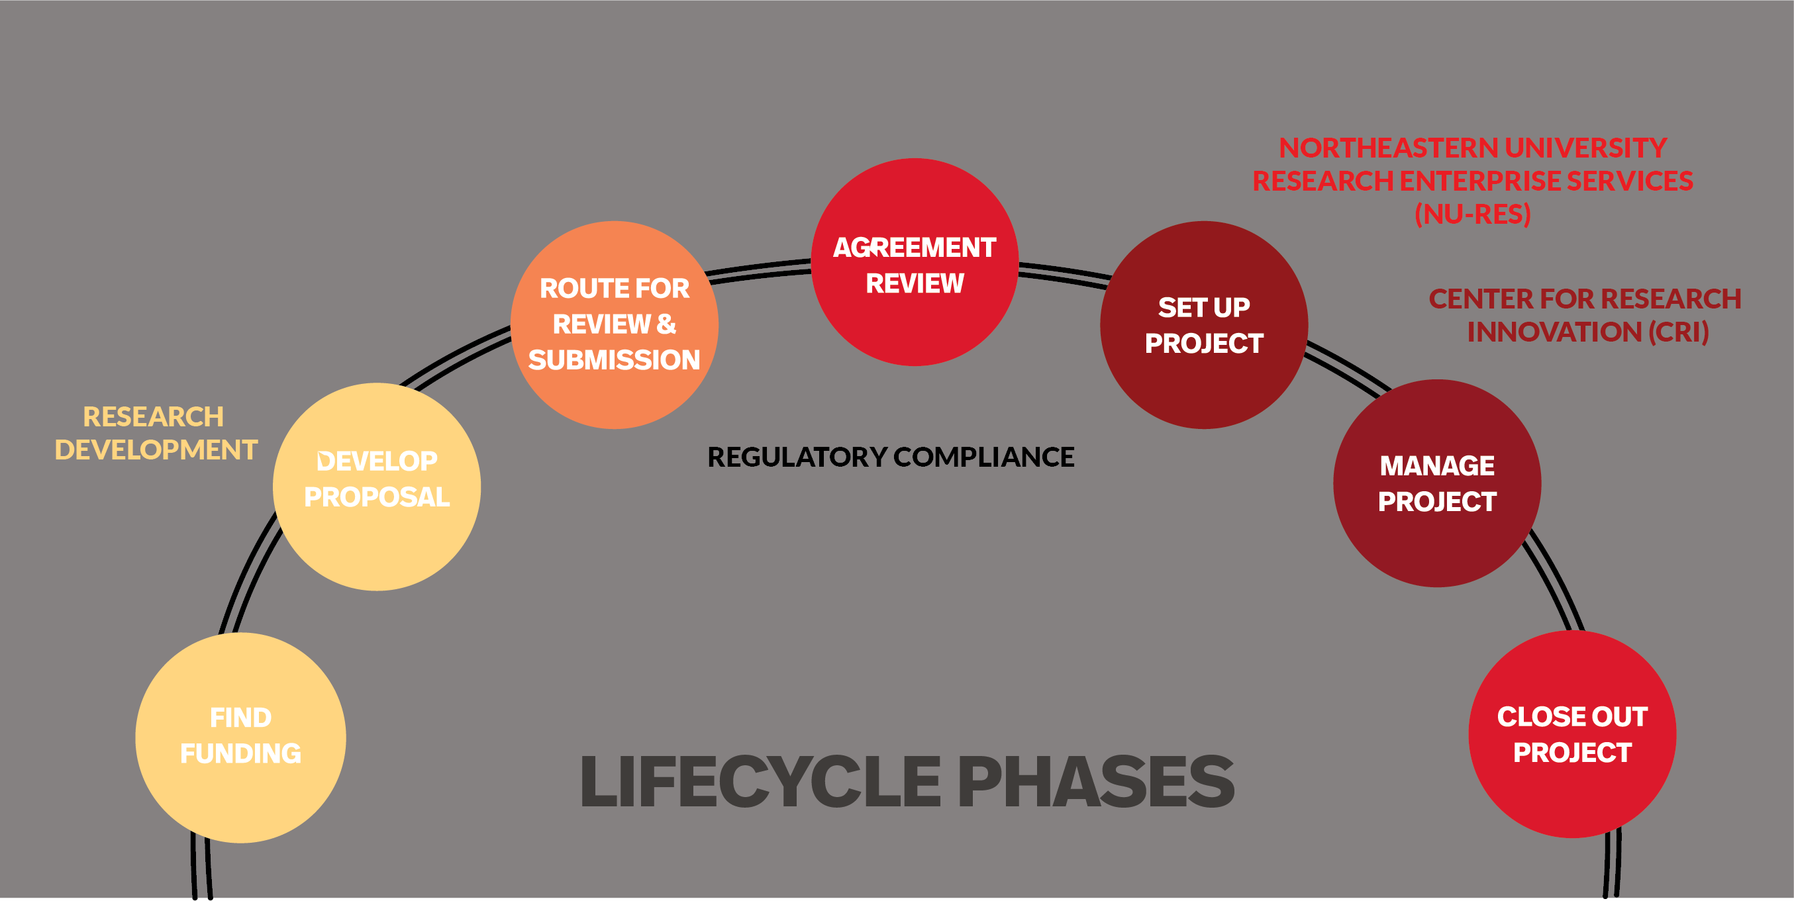
Research Development Lifecycle
Notes:
Research Development can provide support in coordination with college level resources:
Identification of funding opportunities
Organizing and convening around topical areas of interest and targeted opportunities
Connecting Faculty to other relevant internal and external resources

Slide 32
Finding Funding
Office of Research Development!

Slide 33
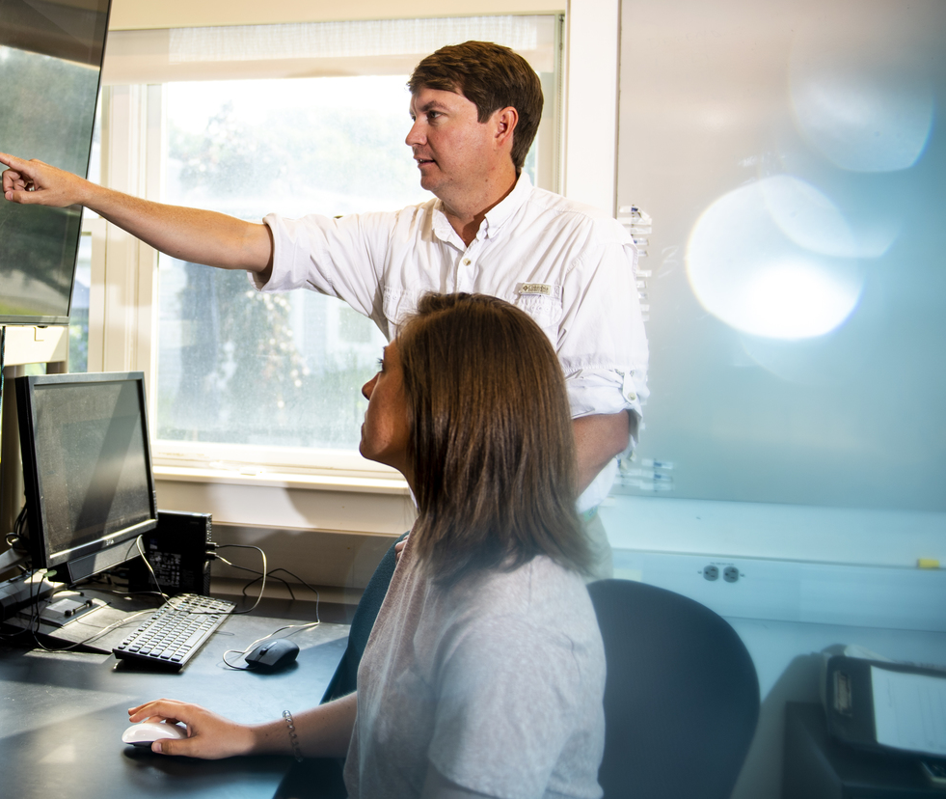
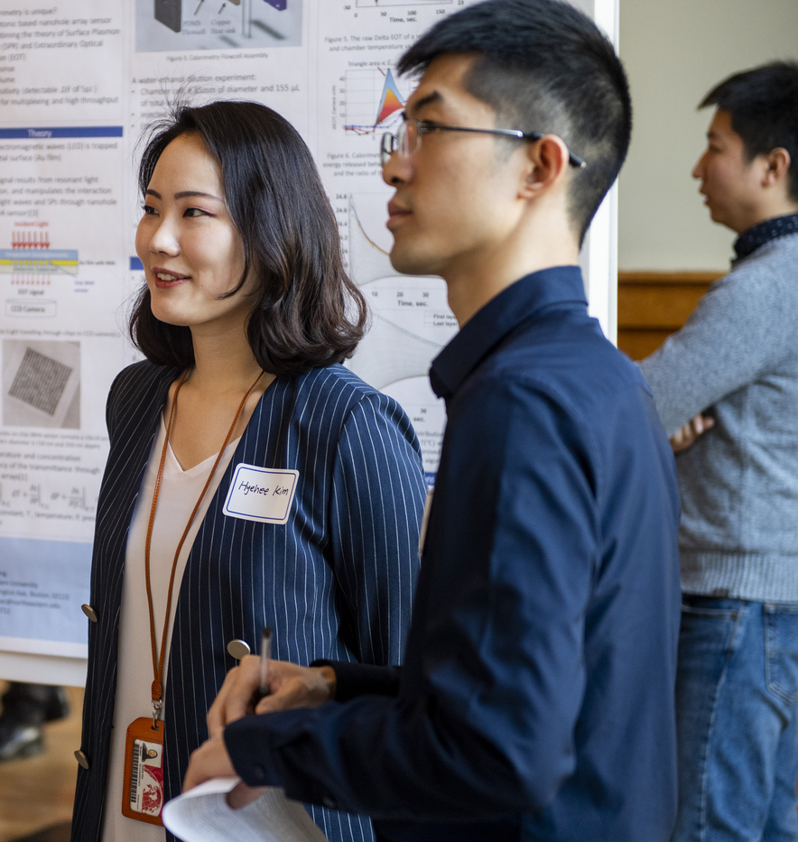
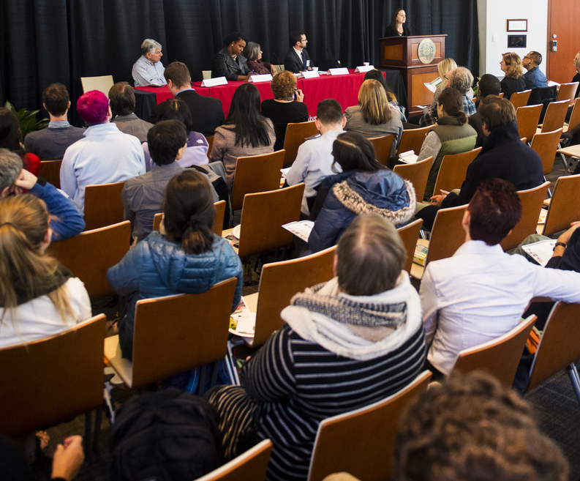
Finding External Funding
  Research Development staff identify and curate funding opportunities and share via targeted emails to researchers
  Pivot Database of funding opportunities
    pivot.proquest.com/funding
  Internal database of Limited Submissions: Funding Announcements Archive - Research Development at Northeastern University
  Additional Resources include Foundation Directory Online & Philanthropy News Digest email alerts

Slide 34
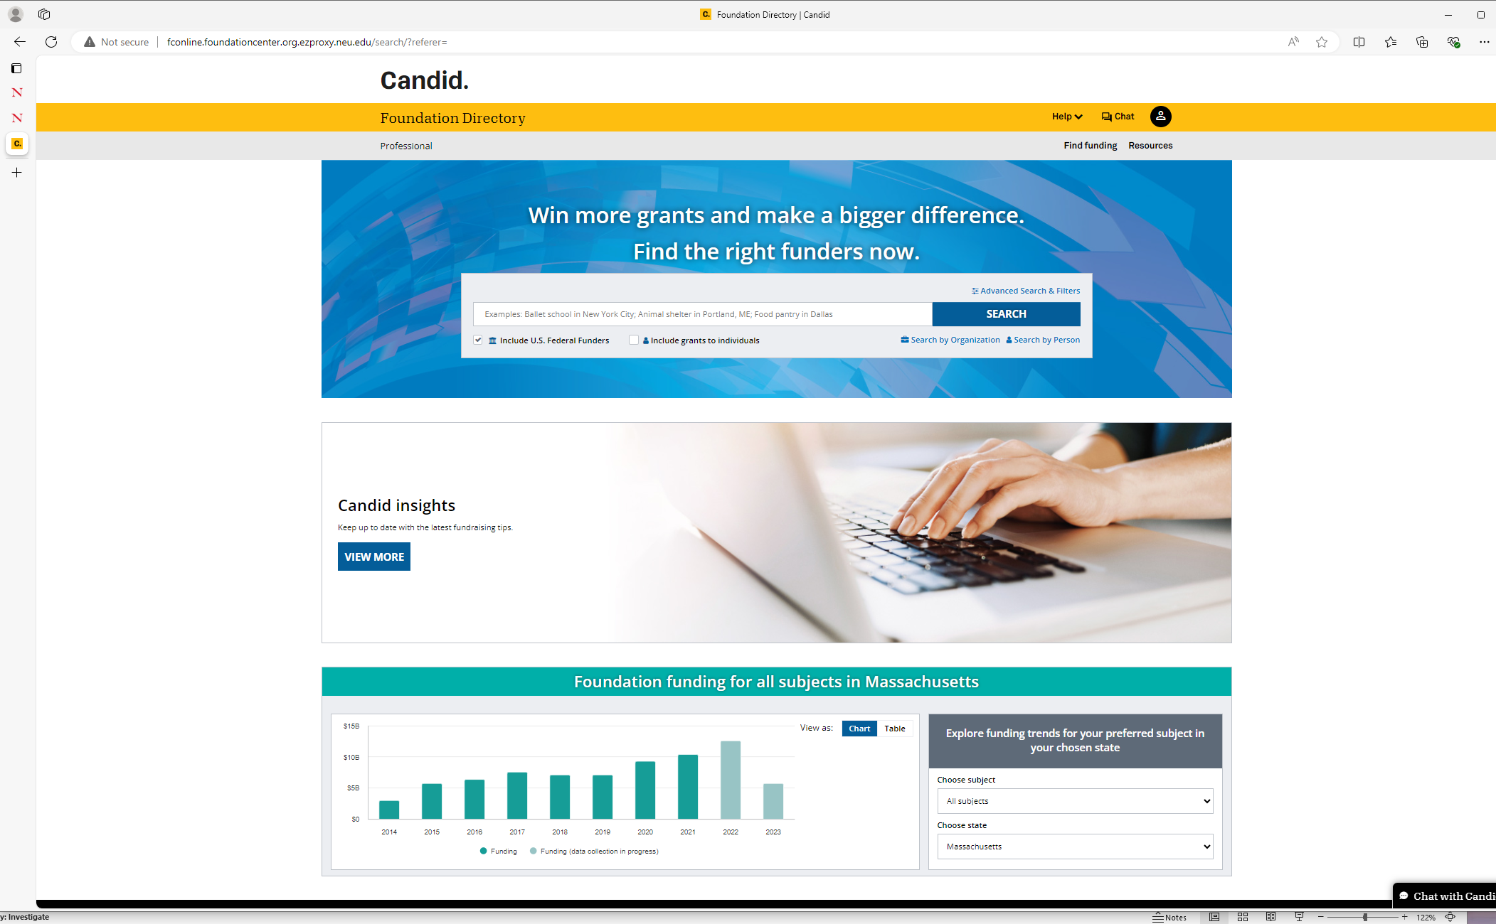

Slide 35
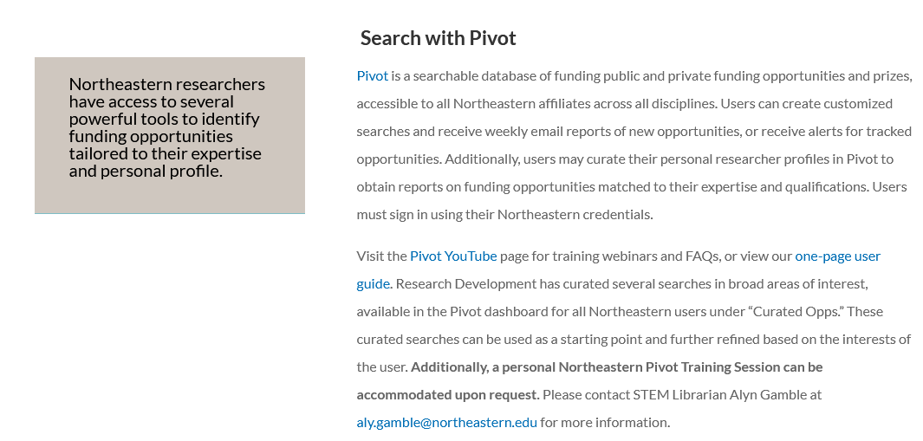
Pivot
https://resdev.northeastern.edu/pivot-funding-search/

Slide 36
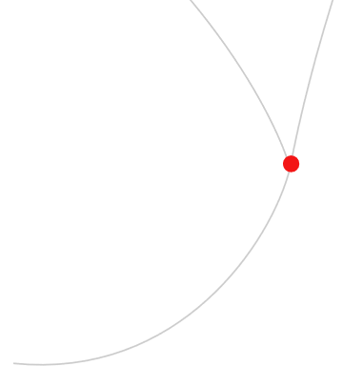
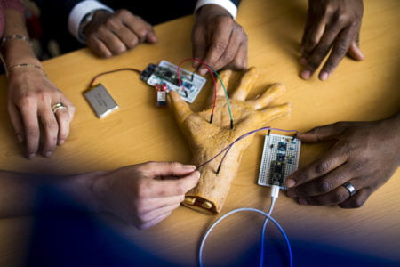
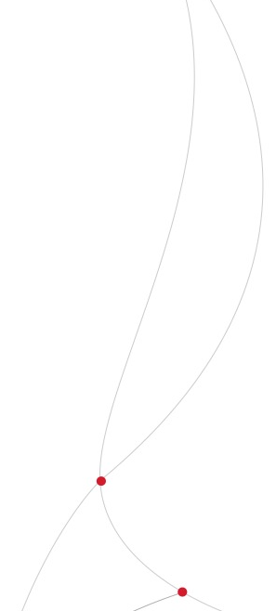
Internal funding: TIER 1
Transforming Interdisciplinary Experiential Research
Researcher Positioning
& Teaming
Funding Opportunities
Provides funds to support interdisciplinary teams to secure proof of concept, with a goal of successfully competing for future external sponsored research opportunities
Multiple fifteen-month grants of up to $50,000 are awarded each year
Proposals must address “NABC” Review Criteria: Need, Approach, Benefits/Costs, Competition
Opportunity to build collaborations across campuses and across disciplines

Slide 37
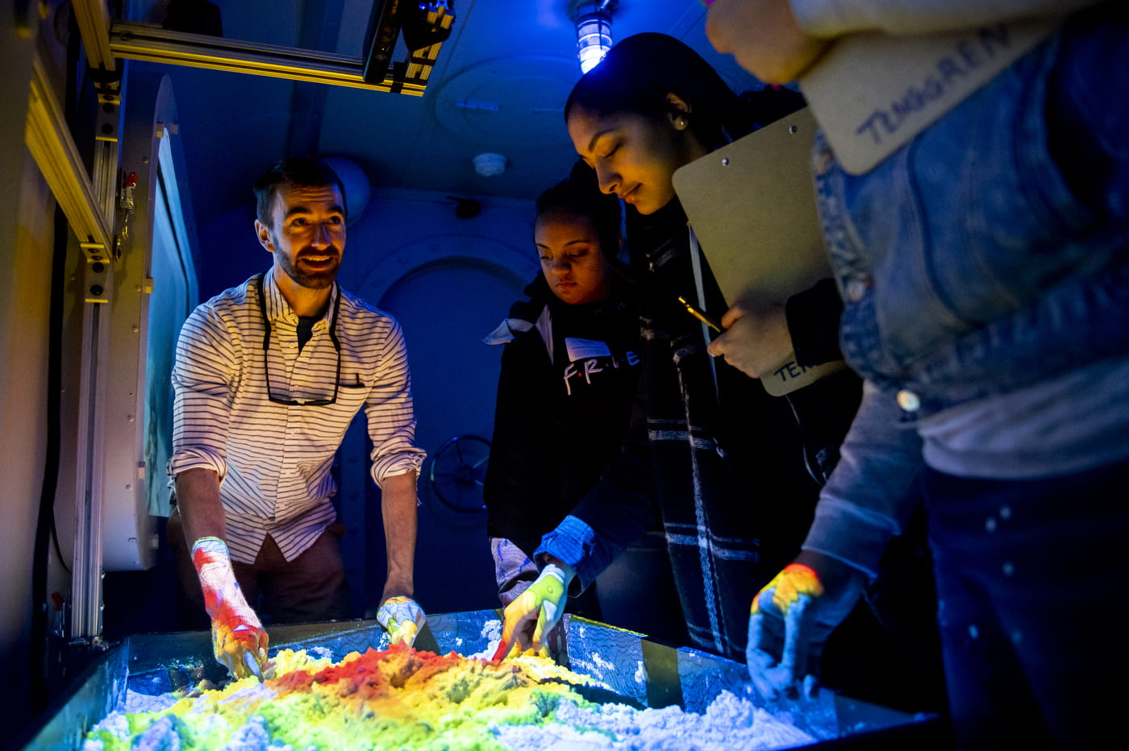
Internal funding: Impact Engines
A new model for 21st century problem solving
Funding Opportunities
Researcher Positioning
& Teaming
Key pillar of Northeastern’s Academic Plan
Positions Northeastern as a leader in research with broad societal impact
Fosters interdisciplinary learning, research, and partnerships to solve challenges with the goal of maximum impact
Spans and connects diverse disciplines, colleges, campuses, industry sectors, and communities around problem solving
Website has more info: https://impactengines.northeastern.edu/

Slide 38
Faculty Professional Development Opportunities
Office of the Provost
The Center for Advancing Teaching and Learning Through Research (CATLR)
Research Development
University-wide Resources

Slide 39

Read more and register on the ADVANCE Office calendar: faculty.northeastern.edu/advance/events

Slide 40

Establishing a Research Program in STEM
Designed for new tenure-track assistant professors in STEM fields, this workshop demystifies critical elements of setting up a laboratory.
Included are developing a mission statement, hiring students, and establishing a research plan.
Wednesday, October 16, 2024
12:00 – 1:30 p.m. ET
Virtual
Registration Link
Facilitators
Penny Beuning
  Professor and Chair of Chemistry and
  Chemical Biology, College of Science
Rebecca Carrier
  Professor of Chemical Engineering and Associate Chair of Research, College of Engineering

Slide 41






2024-2025 Writing Groups
Join a facilitated group of colleagues to focus on the writing process and advance your projects. Writing groups provide a peer environment to help you carve out regular writing time each week and give you an opportunity to acquire skills to grow your writing practice. Registration is on a rolling basis throughout the academic year.
Groups and Facilitators
Early Career Writing
Ariel Gomez
Future Faculty Postdoctoral Fellow in Public Policy and Urban Affairs
College of Social Sciences and Humanities
Full-Time Non-Tenure Track Faculty
Peter Fraunholtz
Assistant Teaching Professor in History and International Affairs
College of Social Sciences and Humanities
(Re-)Writing your First Proposal
Andrea Stith
Director, Research Development
Khoury College of Computer Sciences
STEM
Michael McCluskey
Associate Teaching Professor in English College of Social Sciences and Humanities
Women of Color in the Academy
Nicole N. Aljoe
Professor of English and Africana Studies College of Social Sciences and Humanities
All Disciplines
Emily Avery-Miler
Associate Teaching Professor in English
College of Social Sciences and Humanities

Slide 42


Daunted?

Slide 43





Back to Basics
Reflection
Take the time
Use the tools
Reach out
Deep breaths
This Photo by Unknown Author is licensed under CC BY-NC-ND

Slide 44

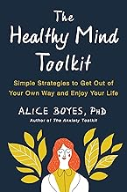
Mental Health Matters
Shape Your Daily Work to Benefit Your Mental Health
Tuesday, October 29, 2024
10:00 – 11:30 a.m. ET
Virtual
Registration Link
Facilitator
Dr. Alice Boyes
Clinical Psychologist,
Researcher, and Author
Join psychologist and former clinical researcher-turned-author Dr. Alice Boyes to improve your mental health and optimize your time for greater success.
This workshop is a part of the Mental Health Matters series.

