Slide 1
Promotion for Full-time Non Tenure-Track Faculty
Deb Franko
Senior Vice Provost for Academic Affairs
Office of the Provost
October 10, 2024

Slide 2
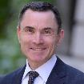
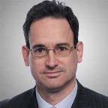
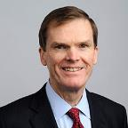
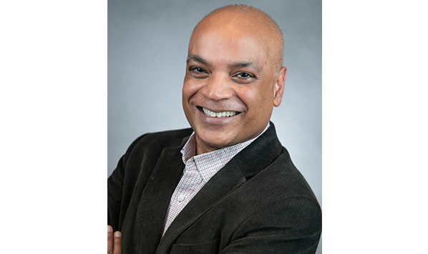
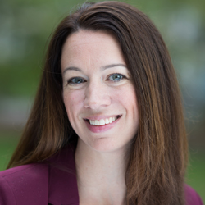
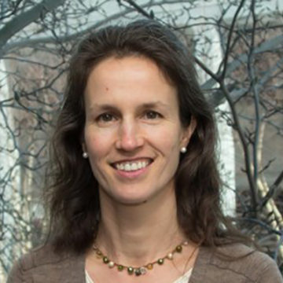
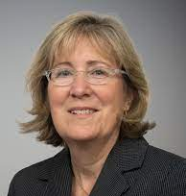
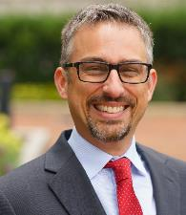
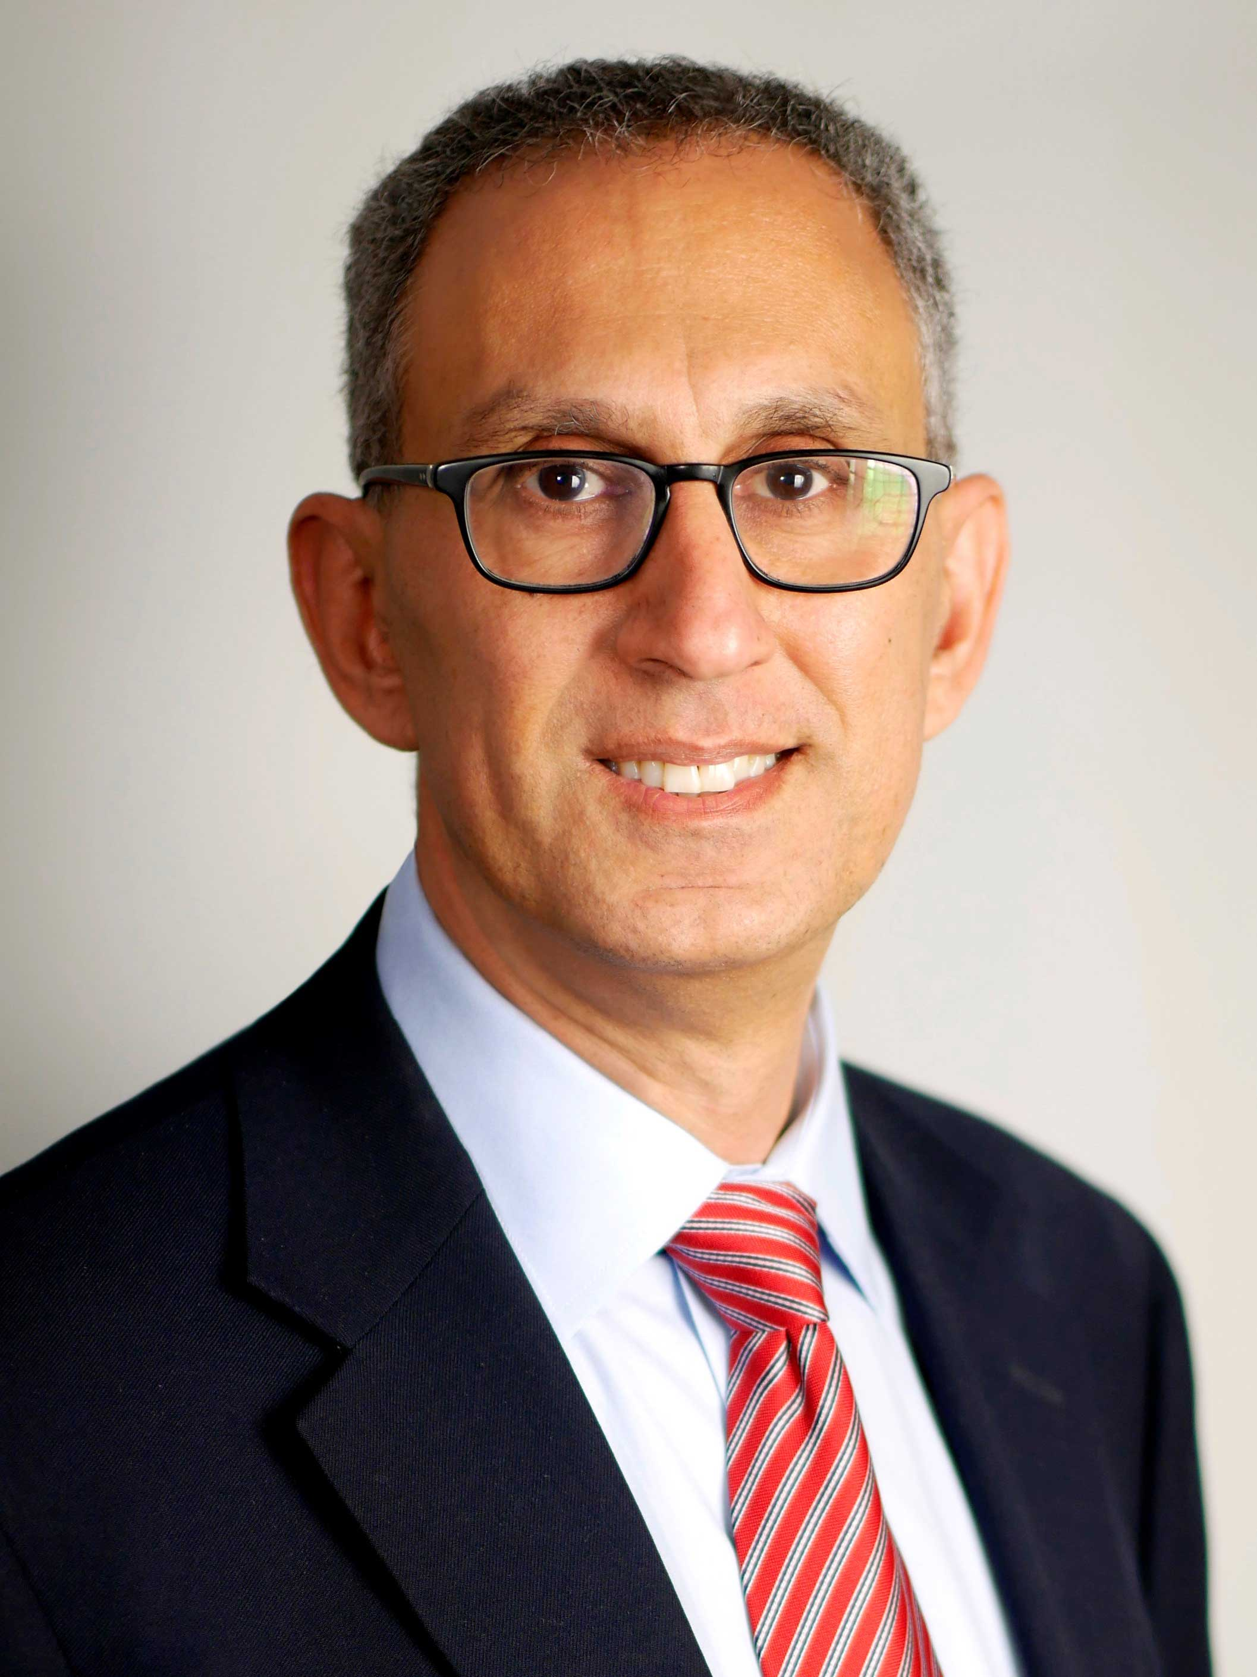
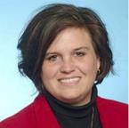
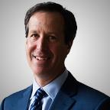
Office of the Provost
David Madigan
Provost and
Senior Vice President for
Academic Affairs
Debra Franko Senior Vice Provost, Academic Affairs | David Luzzi Senior Vice Provost, Research and VP, Innovation Campus at Burlington, MA | Thomas Sheahan Executive Vice Provost | Carolyn Bargoot Deputy Provost | Srinivas Tadigadapa Senior Vice Provost for Institutes, Centers, and Impact Engines
Jane Amidon
Vice Provost, Academic Programs
Jackie Isaacs
Vice Provost, Faculty Affairs
Michael Pollastri
Senior Vice Provost
Waleed Meleis​
Vice Provost for
Graduate Education
Sara Wadia-Fascetti Vice Provost for the PhD Network
Dan Cohen
Vice Provost, Information Collaboration and
Dean of the Library
Notes:
DLF

Slide 3
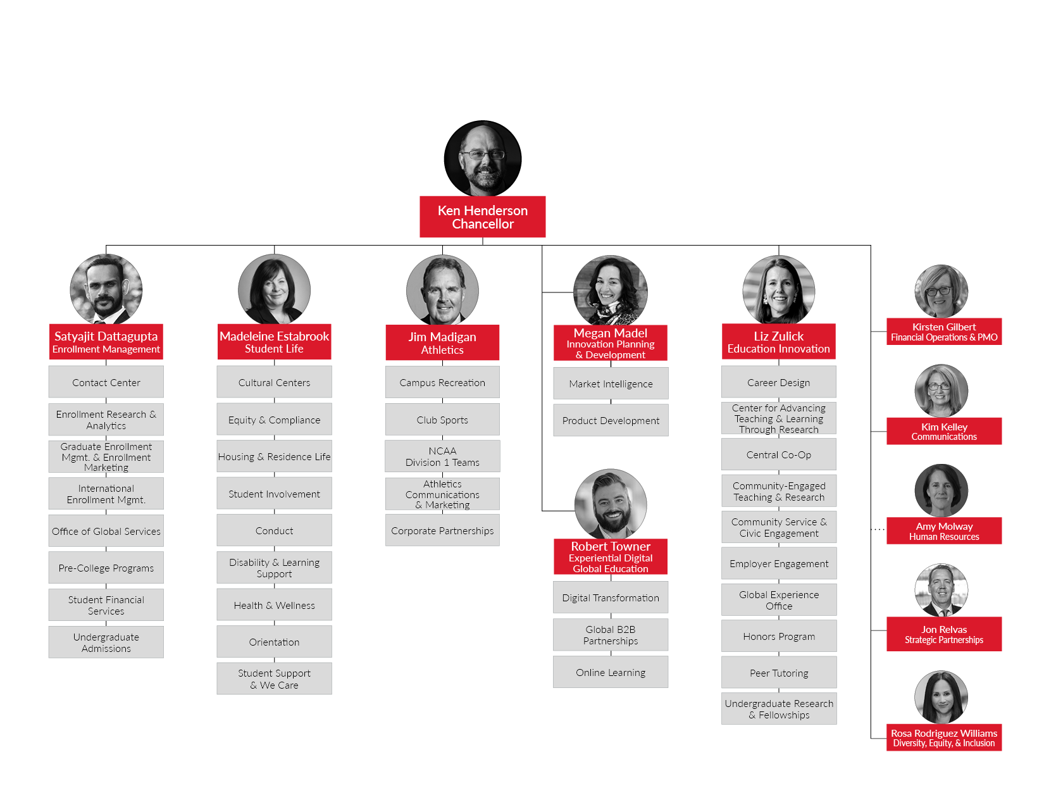
Office of the Chancellor

Slide 4
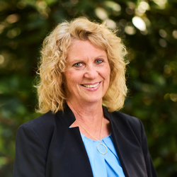
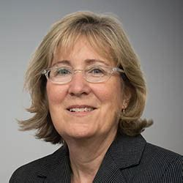
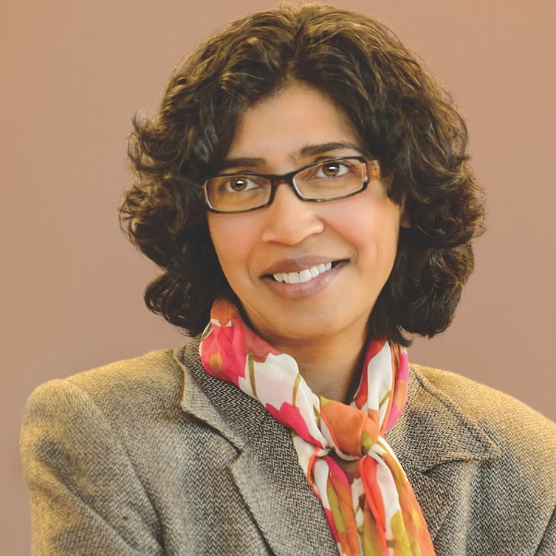
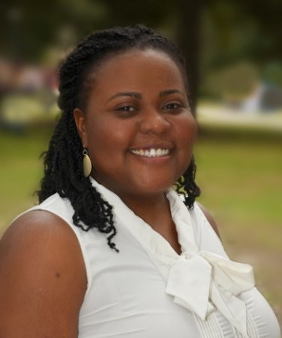
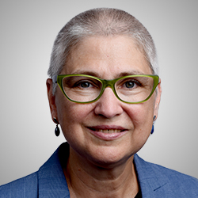
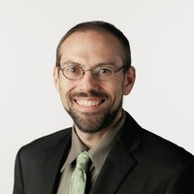
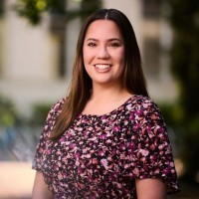
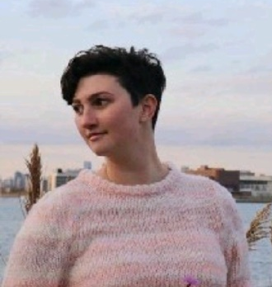
Office of the Senior Vice Provost for Academic Affairs
Deb Franko
SVP Academic Affairs
Jackie Isaacs
Vice Provost for Faculty Affairs
Rashmi Dyal-Chand
Vice Provost Academic and Faculty Administration
Otonye Braide-Moncoeur
Provost Fellow for Faculty Awards and Recognition
Diane Levin
University Ombuds
Jon Barrows
Senior Compensation Analyst
for Faculty Affairs
Kelly Flannery
Special Assistant & Project Manager
Kim Long
Executive Assistant

Slide 5
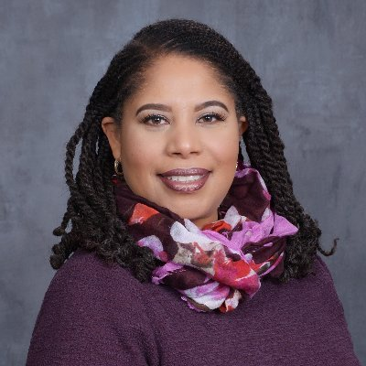
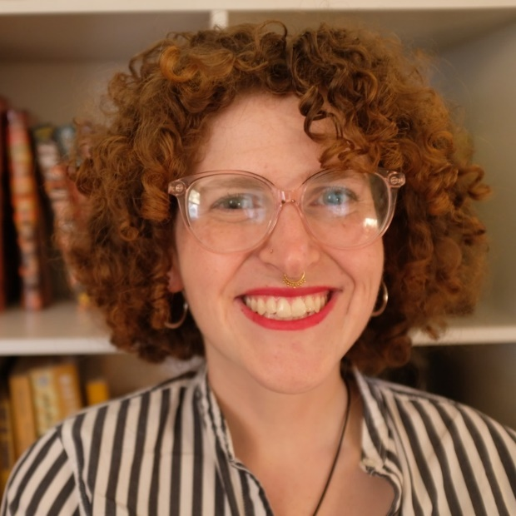
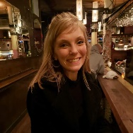
Office of the Senior Vice Provost for Academic Affairs
ADVANCE
Office of Faculty Development
Diedra Wrighting
Executive Director
Sarah Banning
Assistant Director
Samantha Stokoe
Program Manager

Slide 6
ADVANCE Office of Faculty Development
Contact:
Renaissance Park 490
northeasternadvance@northeastern.edu
Diedra Wrighting,
Executive Director of ADVANCE Office of
Faculty Development
d.wrighting@northeastern.edu
https://faculty.northeastern.edu/advance/

Slide 7
Types of Full-Time Non Tenure-Track Faculty 1 Each with different roles & responsibilities
Teaching Professors
Clinical Professors
Academic Specialists
Full-time Lecturers
Professors of the Practice
Co-op Coordinators
Research Professors
Can be found online:
https://provost.northeastern.edu/app/uploads/Full-Time-Non-Tenure-Track-Faculty-Titles.pdf

Slide 8
Northeastern is committed to your success and advancement!

Slide 9
Institutional Background
Since 2017:
370 FT NTT dossiers reviewed
97% success rate
Spring 2010: 6 FT NTT promotion dossiers reviewed and approved in Provost’s office (100% success rate)
Spring 2013: Faculty Handbook modules established the titles of FT Lecturer and Professor of the Practice
Spring 2015: “Teaching Professor” title series implemented, built upon existing Academic Specialist ranks
Spring 2017: 42 FT NTT promotion dossiers reviewed and approved in Provost’s office (93% success rate)
Spring 2018: 59 FT NTT promotion dossiers reviewed (95% success rate)
Spring 2019: 60 FT NTT promotion dossiers reviewed (96% success rate)
Spring 2022: 68 FT NTT promotion dossiers reviewed (100% success rate)
Spring 2023: 74 FT NTT promotion dossiers reviewed (100% success rate)
Spring 2024: 67 FT NTT promotion dossiers reviewed (97% success rate)
Notes:
In 2010, we promoted Academic Specialists, Clinical Professors, and Co-op coordinators. “Teaching Professors” didn’t exist yet, and there was no rank track for lecturers.

Slide 10
Procedural Requirements for Promotion
Minimum service of 3 years in present rank (policy per Senate Resolution and Provost Approval in 2016)
Candidate makes the decision when to come up by alerting the Dean’s office of intention by April 1 in the year prior to dossier submission
Preparation & submission of dossier by October 1 in 4th year
Review of dossier in unit and college according to their procedures and bylaws
Dossier with all recommendations due by February 15 to the Office of the Provost

Slide 11
Variation by college and/or unit
Composition of promotion review committee varies by unit
Weighting of dossier categories varies by unit and appointment category
Research Professors, e.g., by contrast with Teaching Professors
Service assignments vary
Accreditation and/or clinical requirements relevant to some colleges (BCHS, DMSB)
Co-op Coordinator dossier includes different elements
External letters not required by the university but may be by the unit/rank
Employer letters for co-op faculty promotion
BCHS requires 3 external letters for promotion to Clinical Professor

Slide 12
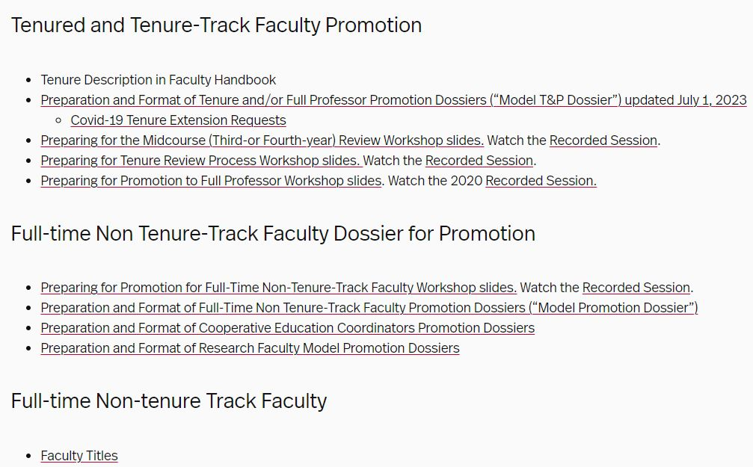
Online Resources
Information Available at the Faculty Resources Web Site
https://provost.northeastern.edu/resources/faculty/

Slide 13
Submission Portal: INTERFOLIO
The software package from Interfolio is used for both dossier submission and dossier review
It is a simple straightforward program much like those used for manuscript submission
Training will be available from your college’s associate dean for faculty affairs (when the time comes)

Slide 14
Interfolio Candidate Experience

Slide 15
Review at University Level
Advisory Committee to the Provost on FTNTT promotions (since 2016)
It includes associate deans of faculty affairs in the colleges and Vice Provost for Faculty Affairs
Half-day meeting is held to review dossiers
SVPAA recommends FTNTT promotions to the Provost for final review and approval
Faculty member receives notification on May 1

Slide 16
The Dossier
Components of the dossier are detailed in the Model Promotion Dossier document found under “Academic and Faculty Affairs” on the Provost website: https://provost.northeastern.edu/faculty-affairs/
Resources
Preparing for Promotion for Full-Time Non-Tenure-Track Faculty Workshop slides
Preparation and Format of Full-Time Non Tenure-Track Faculty Promotion Dossiers (“Model Promotion Dossier”)
Preparation and Format of Cooperative Education Coordinators Promotion Dossiers
Preparation and Format of Research Faculty Model Promotion Dossiers
Checklist is a key document found in Model Promotion Dossier
Review contents carefully

Slide 17
Dossier Materials Added by Unit and College
Faculty Summary Sheet (Model C in Model Promotion Dossier) – prepared by the Dean’s Office
Recommendations – added by unit chair, departmental review committee (where applicable), college committee (where applicable), and college dean
External Reviews – added by department review committee (if applicable)

Slide 18
Candidate Dossier Materials
Candidate’s Comprehensive Dossier Curriculum Vitae
E. Candidate’s Statements and Supporting Evidence
Teaching Statement (5 pages) and Teaching Evaluation Summary Table
Professional Development and Scholarship/Creative Activity Statement (2 pages)
Service Statement (1 page)
Annual Performance Reviews
Comprehensive List of Supporting Materials in Appendices A,B,C

Slide 19
Appendices
Appendix A: Teaching Supporting Documents
Full reports of TRACE evaluations
Sample syllabus
Teaching materials
Appendix B: Professional Development and Scholarship/Creative Activity
Evidence of professional development
All publications
Supporting Materials
Appendix C: Service Activities
Service supplemental materials
NOTE: NO PAGE LIMIT ON APPENDICES (but be reasonable)

Slide 20
What Makes a Strong Dossier?
Evidence of sustained contribution in your areas of responsibilities
Evidence of professional development and growth in your areas of responsibilities

Slide 21
Evidence of Sustained Contribution in Teaching & Learning
Course materials that are current, appropriate to your field, and focused on student learning outcomes
Course design and assignments at an appropriate level of student engagement and challenge
Sample rubrics, examples of feedback to students
Student and peer evaluations demonstrating consistent, responsible, responsive and challenging instruction
Other evidence of student outcomes (awards, publications, GR school admissions, etc.)

Slide 22
Evidence of Professional Development and Growth in Teaching
Might include, in addition to established strong classroom performance . . .
Engagement with CATLR workshops and grants
Wider range of courses developed and taught
Curricular and pedagogical improvement/innovation
Mentoring of junior faculty
Participation in and contributions to your field’s pedagogical debates

Slide 23
Evidence of Professional Development & Growth in Service
Especially at “full” rank, may include, in addition to reliable citizenship . . .
Wider program, college and/or university leadership roles with demonstrable outcomes (e.g., Senator, Faculty Senate committees)
Visible professional service premised on your teaching and/or professional experience and innovation
Responsibility for programmatic improvement as well as continuity
Development of junior colleagues

Slide 24
How Do I Prepare for Promotion?
Launch conversations and planning ahead of the year in which you hope to submit application for promotion
Seek specific, targeted advice from your chair and your dean
What are the strengths and weaknesses of my trajectory from the standpoint of promotion?
What are the most important things I can do to improve my trajectory?
Attend college and university workshops on process
Review FTNTT Model Promotion Dossiers (Teaching/Co-op/Research)
https://provost.northeastern.edu/resources/faculty/
Systematize your collection of dossier-related materials

Slide 25
Resources
With counsel of your chair and dean, draw on resources to strengthen your trajectory
CATLR workshops, one-on-one advising, grants
College- and discipline-specific programming
ADVANCE Office of Faculty Development offerings
Full-time Non Tenure-Track Faculty Fellowship Program
Full-time Faculty Development funding to support:
Advanced professional training; Conference travel
Research in teaching and learning
Call for proposal sent to the colleges each spring (notification of funding decision made in May)

Slide 26
Questions?

Slide 27
Thank you!

